Slide 1
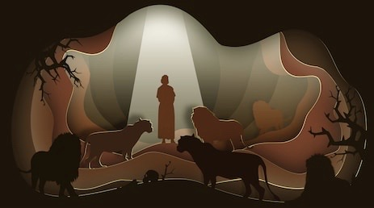
Living Godly in an Ungodly Land
Be Devoted

Slide 2
What is the greatest change?

Slide 3
Everything will get better once we get through this…?
September 11, 2001
For a time the country was unified against terrorism
How long did that last?
Things changed but not totally

Slide 4
I believe the greatest change is what happens inside of you

Slide 5
Daniel spent many decades in Babylon
He had experienced a lot of changes
The life around Daniel was anything but stable
This didn’t stop Daniel becoming stronger in his faith, trust, and love for God
His devotion despite the chaos around him

Slide 6
Be devoted in your preparation before God
Daniel’s prayer was made in response to reading “word of the Lord through Jeremiah the prophet” (9:2)
Daniel’s connection to God was tied to his understanding of His Word
Are our prayers to God connected to the reading and understanding of His Word?
Daniel took what he had read and prepared for prayer

Slide 7
“I set my face toward the Lord God”
“by prayer and supplication with fasting, sackcloth, and ashes”
All three actions were visible sign of heartfelt lament
Daniel shows us that attitude is just as important as our words in prayer
Will we take the necessary time to turn off the world and turn to God to change our attitude, perspective, and understanding?

Slide 8
Be devoted in your position before God
There are two parts to this beautiful prayer: Confession and Petition
Daniel’s confession is not one dimensional
He confess sins and in the greatness of God
“We have sinned and committed iniquity” (9:4)
The problem was not with the empires but the sin of God’s people

Slide 9
Why is Daniel grouping himself with those who clearly failed to listen and sinned against God?
He is not above dressing in sackcloth and ashes and counting himself among those who sinned
Jesus became sin for us so that we might be made righteous of God (2 Corinthians 5:21)
Faith needs a willing heart, open hear, and humble attitude

Slide 10
Be devoted in your petition before God
Daniel switched to confession to petition (9:15)
He wanted God to restore the city of Jerusalem and His people
He grounds this petition not in people but in the righteousness of God
We need God to act not based on our actions but on His character

Slide 11
The change to be devoted to God no matter the day, year, or time we are in

