Slide 1
Numbers that Count

Slide 2
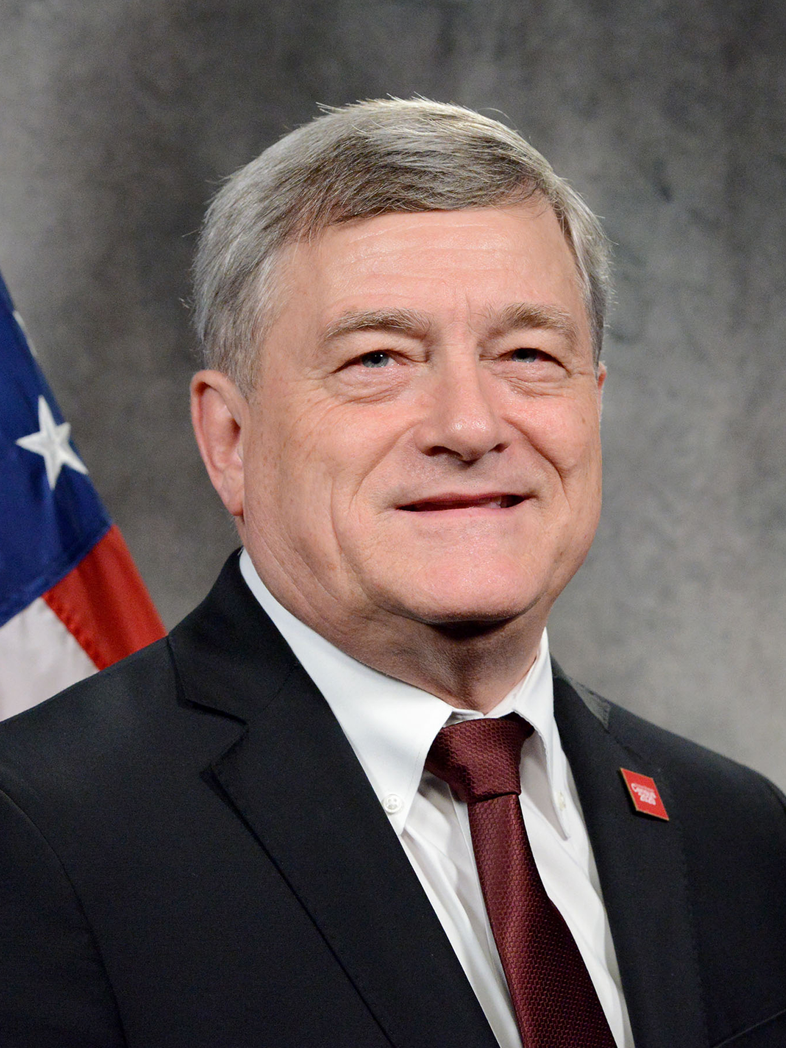
He is an American Statistician
His office prints over 14,000 tons of forms in different languages
Employs more than one million counters to count America
America’s first census was 1790 with a population of 3.9 million
Dr. Steven Dillingham
Census Bureau Director

Slide 3
Do they know how many lives saved by the gospel?

Slide 4
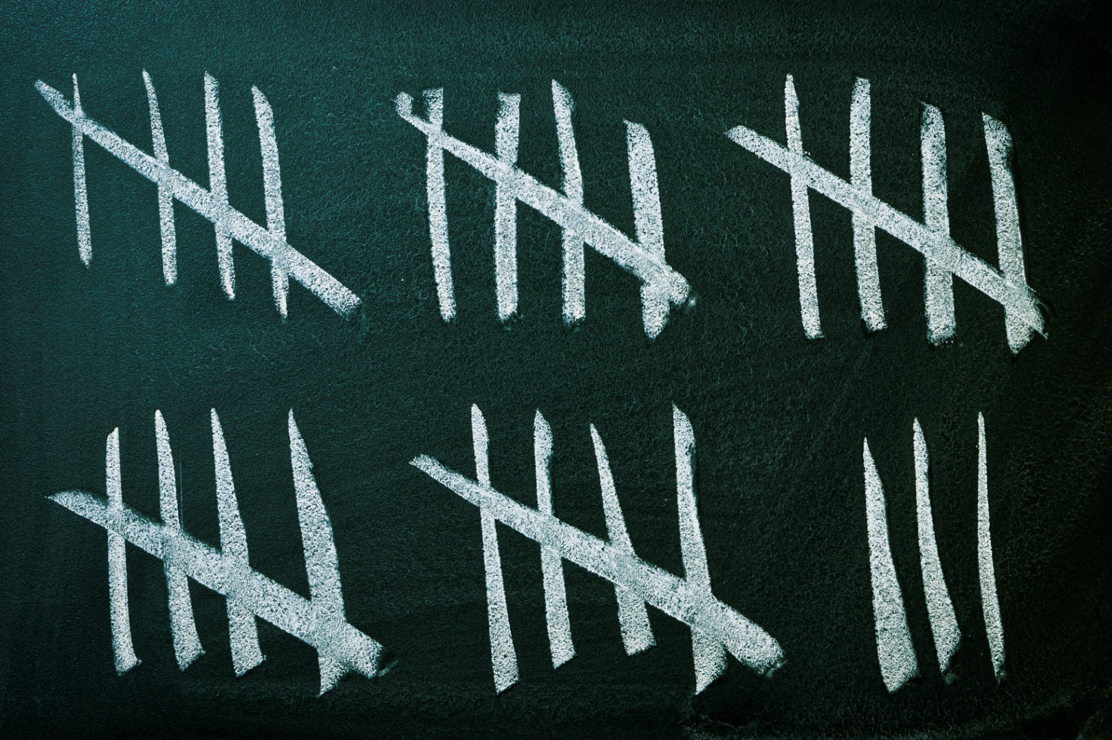
Census counting has a history with God
I Corinthians 3:6 – 7
Acts 2:47
Moses was the first when he numbered the Israelites as they left Egypt
Ezra took a census as Israel found its way back home from captivity
Why all the counting with God?

Slide 5
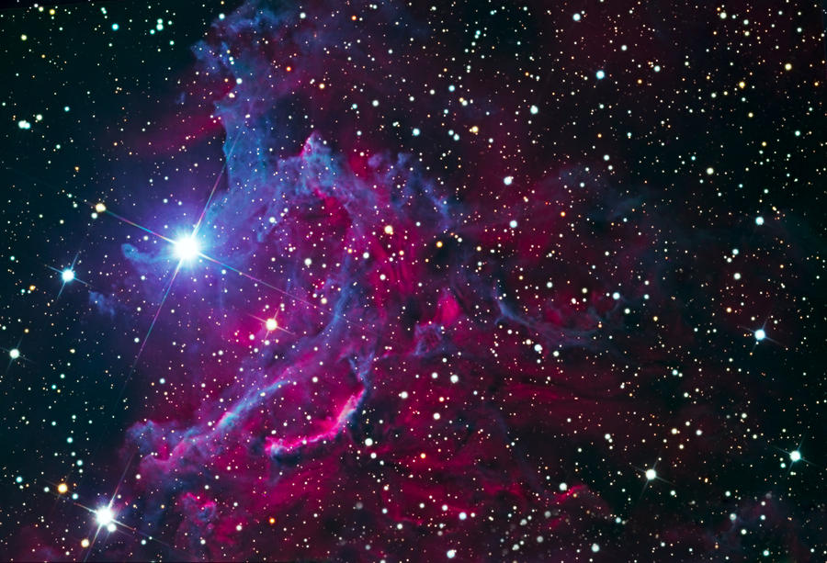
Counting shows the wonders of God
Genesis 15:5 – 6
"Count the stars if you are able to number them”
Abram believed in God
The wonders of God

Slide 6
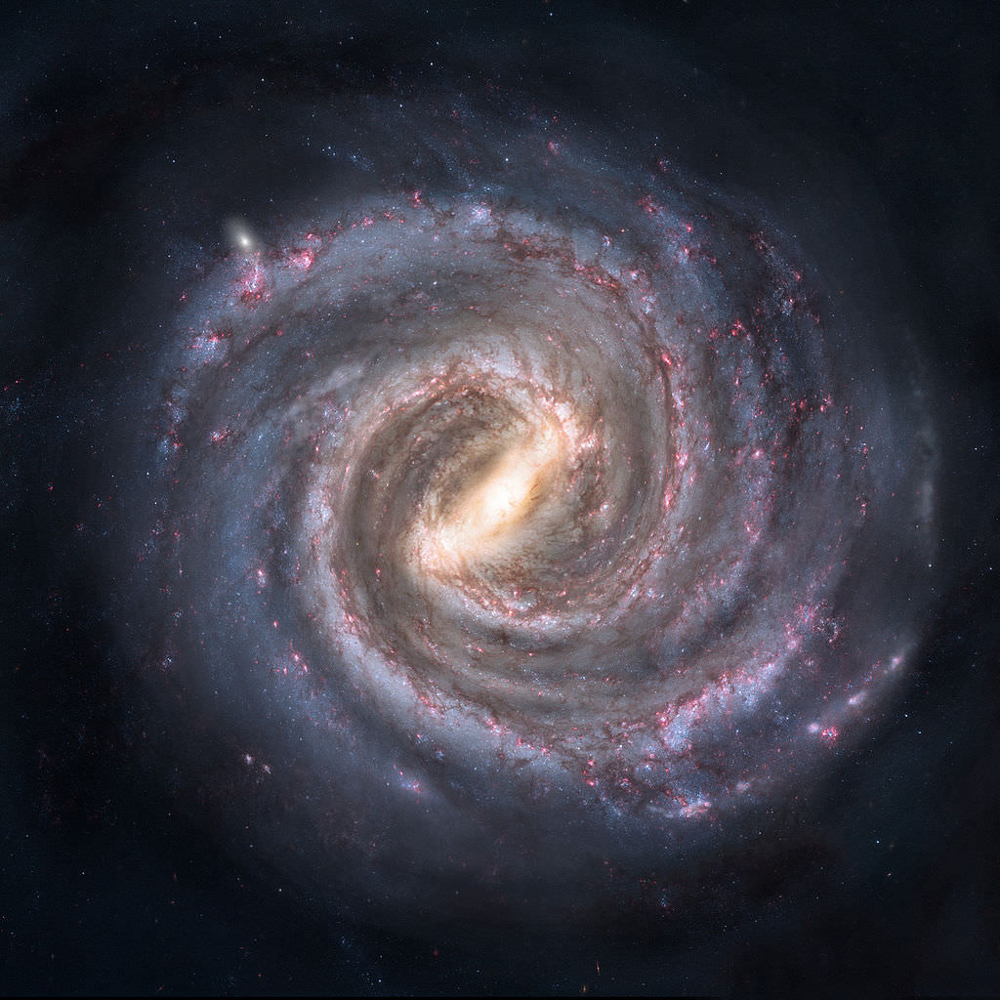
The Milky Way which contains our solar system contains between 100 - 300 billion stars
One guesstimate is 100 octillion stars in the universe
How much is 1 octillion?
100000000000000000000000000000
Proxima Centauri is the closest star to our sun. It’s 4.243 light years away
A light year is 6 trillion miles
God created, counted, and named the stars!

Slide 7
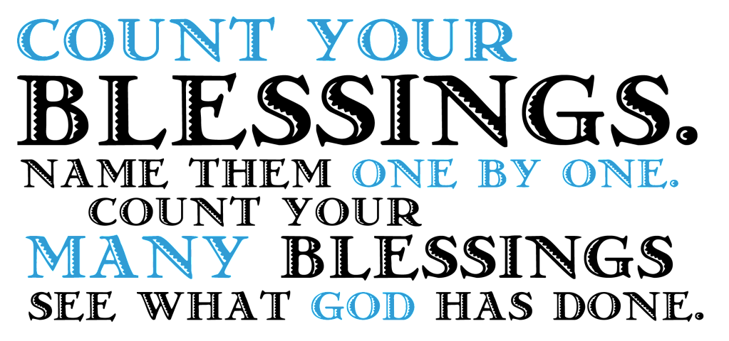
Counting shows the works of God
Can you name everything God has done for you ?
Psalm 40:5, “Many, O Lord my God, are Your wonderful works Which You have done; And Your thoughts toward us cannot be recounted to You in order..”
Could you even count all your blessings?

Slide 8
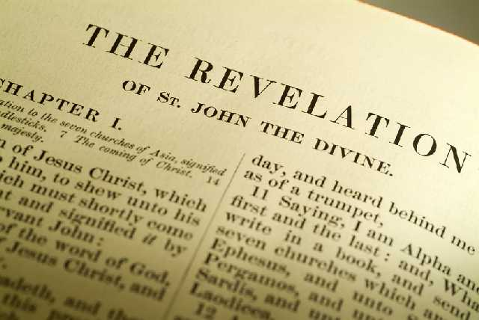
Counting shows the worship of God
John received a might revelation on the island of Patmos (1:9)
He was in the Spirit on the Lord's Day" (1:10)
John saw a peak into the heavenly place
Revelation 5:11 – 14
The heavenly beings were without number
Angels, living creatures, and the elders all worshiping the Lamb
Worship is important around the throne of God

Slide 9
God's count goes deeper

