Slide 1
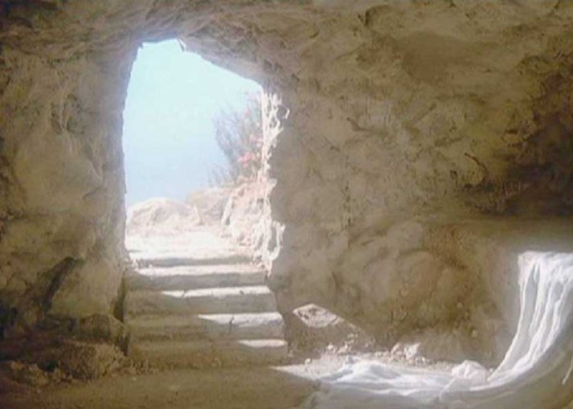
Doubt, Denial, Hope
The Reason for Evangelism
Part IV

Slide 2
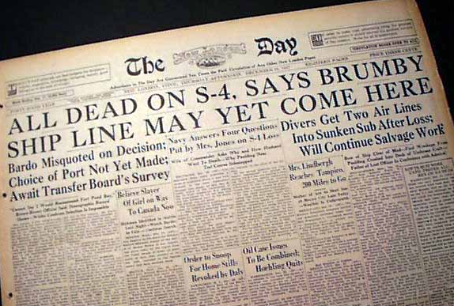

Slide 3
Jesus is the only answer
He faced death and overcame it
He gives us hope
The hope that there is more to life than this life.
Everyone needs hope!

Slide 4
The reason for evangelism is to show the story of Jesus Christ by how we conduct ourselves to others

Slide 5
DOUBT
"He is risen! He is not here!" (16:6)
Can you imagine how these women felt?
Should they be completely surprised?
Mark 9:31
Mark 10:33 – 34

Slide 6
Nobody is expecting a resurrection!
Jesus informed His disciples on three occasions that He would rise on the Third day
Even the angel said to the women "there you will see Him, as He said to you" (16:6)
The resurrection was hard for them to believe
They were skeptical until they saw Jesus
It's imperative that we believe in the resurrection

Slide 7
DENIAL
We find one disciple who was beyond doubt
He had to see the wounds on Jesus' body
He put a spiritual condition on his unbelief

Slide 8
"Unless I see" (John 20:25)
Jesus helped Thomas but He also helps us
The disciples were so certain that they wouldn't dwell in doubt or denial again

Slide 9
HOPE
The Bible and the events in my life confirm there is life after death
I am content with how it all happened
The Resurrection is not just an event
Romans 6:1 – 6

Slide 10
Three stand before us
Doubt, Denial, Hope

