Slide 1
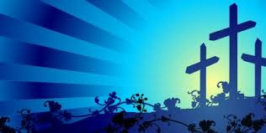
The Darkness, The Temple, The Confession

Slide 2
What to do?
Stay the course
Keep the main thing the main thing
Prayer, Read, Remember

Slide 3
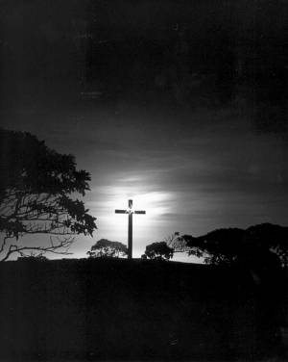
The Darkness
All four Gospels mention darkness
Darkness during the day had expressed God's wrath

Slide 4
Ninth plague was darkness
Tenth plague was done at midnight
God was acting His judgment with the darkness
In darkness Jesus cried, "My God, my God, why have you forsaken Me?"
Judgment that was for us fell on Jesus
This is the reason for us to get out of spiritual darkness

Slide 5
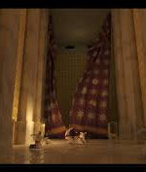
The Temple
The veil was heavy and thick
It separated the people from the presence of God
Only time was Day of Atonement

Slide 6
When Jesus died, this massive veil was ripped open
The tear was from top to bottom
The way to the Father is now approachable
We have access to the Father through and by Jesus

Slide 7
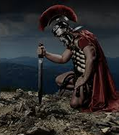
The Confession
"Surely this Man was the Son of God"
The mouth of a Roman centurion (A pagan)

Slide 8
Every Roman would call Caesar the "Son of God"
This centurion gave the title to Jesus
He was the first to confess the deity of Jesus Christ
What penetrated the centurion's darkness?
He heard and saw Jesus

Slide 9
The Darkness
The Temple
The Confession

