Slide 1
Hope in God

Slide 3
We understand joys and sorrows

Slide 4
We know the joys of triumphs and the anguish of defeat
We have tasted glory
We have faced grief
Ups and downs
While we feel down, there is a rock that we can cling to.
Lament leads to hope

Slide 5
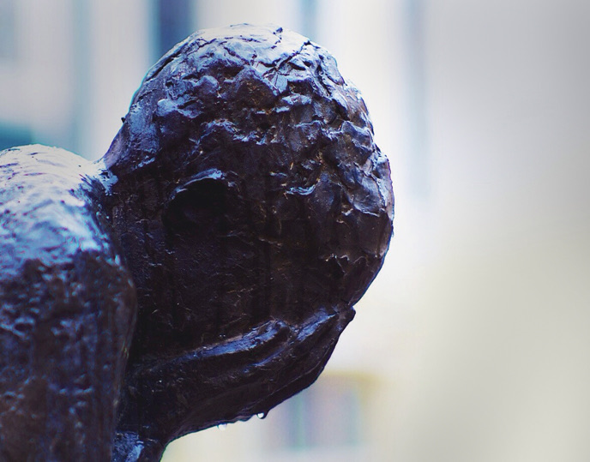
To Lament
“As the deer pants for the water brooks, so pants my soul for You, O God” (42:1)
This is a cry of a true follower of God
The psalmist is suffering as he feels separated from God

Slide 6
God has called us to cast our cares upon Him (I Peter 5:7)
The psalmist shows how we can rightly bring our sorrows before the Lord
Does the psalmist have all the answers? No
Will we have all the answers? No
What should we do? Bring it to the Lord

Slide 7
To Remember
The psalmist lamented but he didn't go to despair
He turns his mind to God
Psalm 42:6-8
We must keep on remembering God

Slide 8
To Hope
“Hope in God”
“Don't listen to yourself; preach to yourself”
Spiritual confidence that God will act and show Himself faithful based on past and future

Slide 9
We must finish like so many before us

