Slide 1

TO THE END

Slide 2
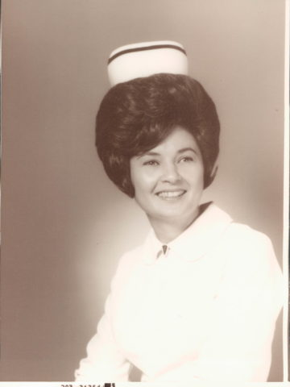
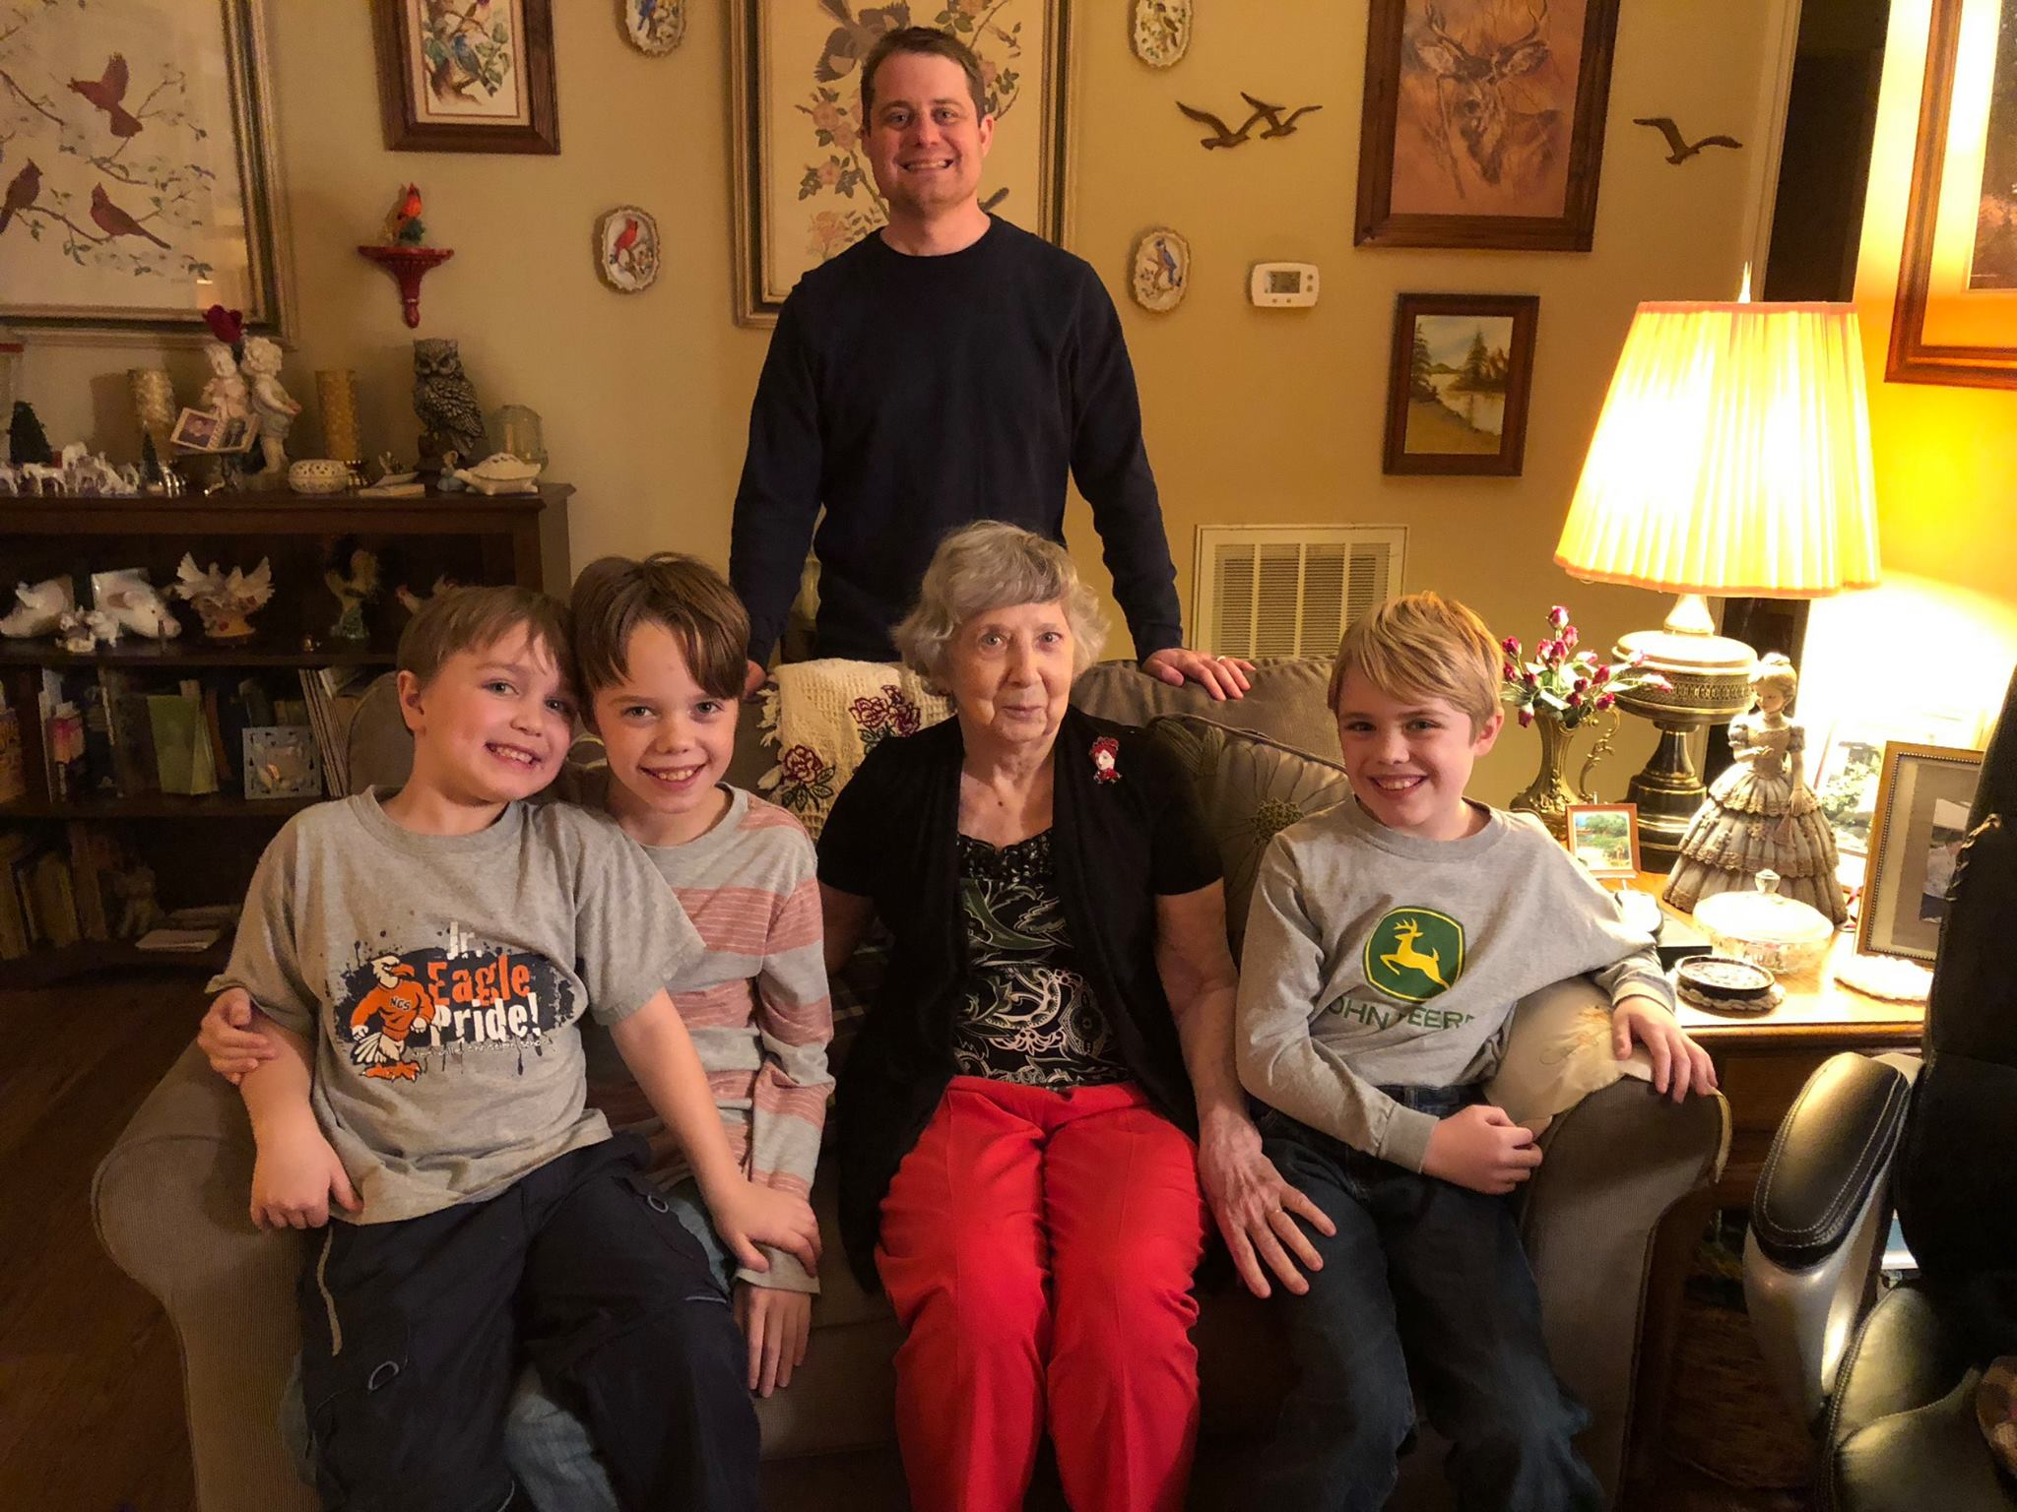
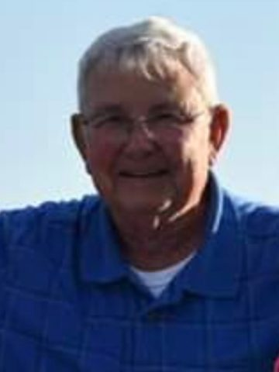
Tough Week

Slide 3
Challenging Weeks
FAITH is mandatory because of the response of those before us

Slide 4
LET US LAY ASIDE THE WEIGHT
“Let us lay aside every weight” (12:1)
What is this “weight”? Anything that keeps us down from serving and pleasing God
We are to “lay aside” (meaning “lay off one’s clothes”)
We need to disconnect from such weight

Slide 5
LET US “RUN WITH ENDURANCE”
“with endurance” (NKJV); “with perseverance” (NIV); “with patience” (ASV)
The Greek word means all three
The verb tense suggests we keep on running
We are in a marathon not a sprint!
We have come too far to quit or give up because of any present moment we face
Does that take away all fear, worry, or concern? No

Slide 6
Like those before, we must us run the race set before us
The Greek word for “race” is where we get our English word for “agony”
It refers to struggles, conflict, or fight
We run what is set before us in our day and time
This is what we are accountable to God for

Slide 7
LET US “NOT BECOME WEARY AND DISCOURAGED”
There is no assurance from God or His Word that our race will end before we do
We may struggle to the end (Many have and do)
This is not to make you worry or become discouraged
Look to Jesus, not people or problems!
He endured His end with joy

Slide 8
I Know Who Holds Tomorrow

