Slide 1
Christ in Carols

Slide 2
What is it about a baby?
We make weird faces
We talk in a completely confusing language
We more mobile for the baby by getting on the floor
Is it the innocence, purity, holiness?

Slide 3
Holy
“Holy” is from the Greek hagios
It carries the idea of something separated from other things
Separated from sin, evil, corruption
Besides God, a baby is close to holiness that we can physical see
Yes, we are holy because of Christ but we needed forgiveness of sins. We carry wounds and baggage
A baby is free from all of that

Slide 4
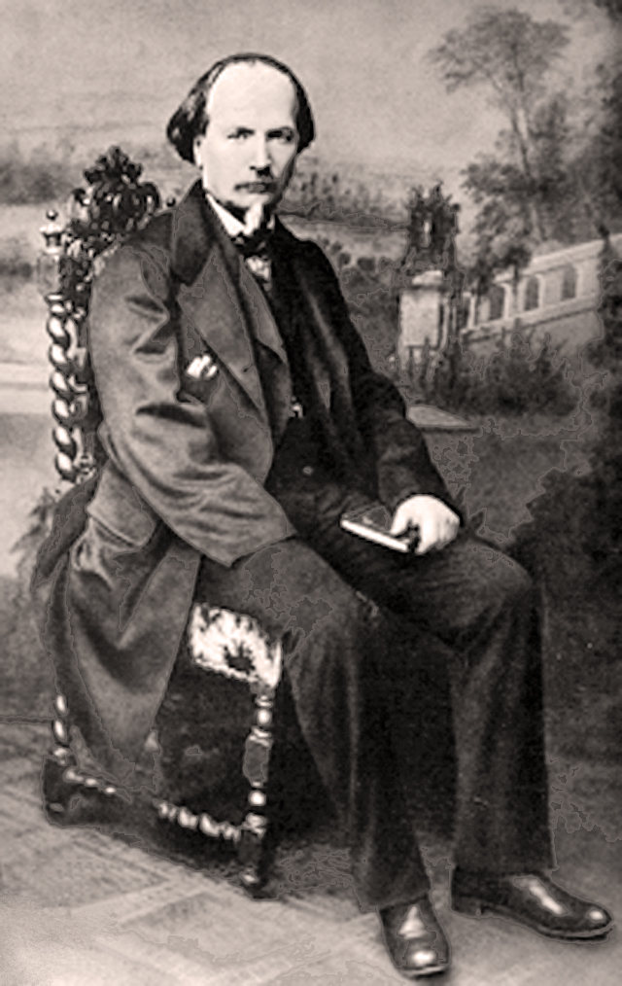
The Story
Placide Cappeau was asked by a Parrish priest to write a poem for a service
Placide was more known for his poetry than his church attendance
He agreed and used the book of Luke as a guide in writing the poem
He was captivated with the thought of “holy night”

Slide 5
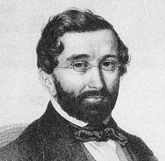
Placide was moved by his own work that he felt it needed to be a song
He turned to his musically inclined friend, Adolphe Adams
Adams was from a Jewish ancestry and he didn’t believe that Jesus was the Son of God
However, he agreed to do it
The song was completed three weeks later
Adolphe Adams

Slide 6
Placide left the Catholic Church to join a social movement
Church leaders discovered Placide departure and that Adams was a Jew
They deemed “O Holy Night” as unfit or unholy
The popularity of the carol was stronger than their attempt to bury the carol

Slide 7
A song poplar today came to be at the request of a priest, a poet who left the church, a Jewish composer, and brought to America to serve as a tool to show the sinful practice of slavery

Slide 8
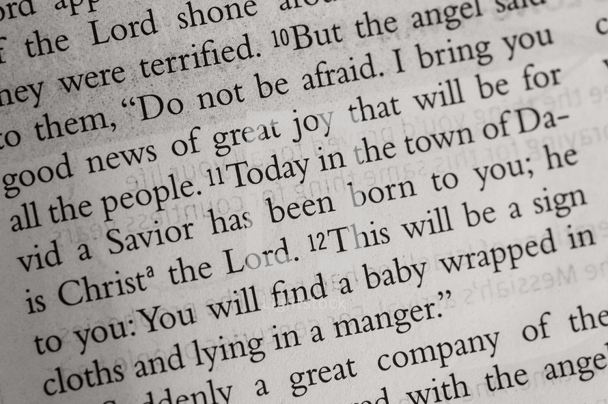
The Scripture
It was a holy night for many reasons
Holy angels (Mark 8:38)
Holy God (Isaiah 46:9)
Holy people ( I Peter 1:16)

Slide 9
Pursue peace with all people, and holiness,without which no one will see God (Hebrews 12:14)

