Slide 1
Christ in Carols

Slide 2
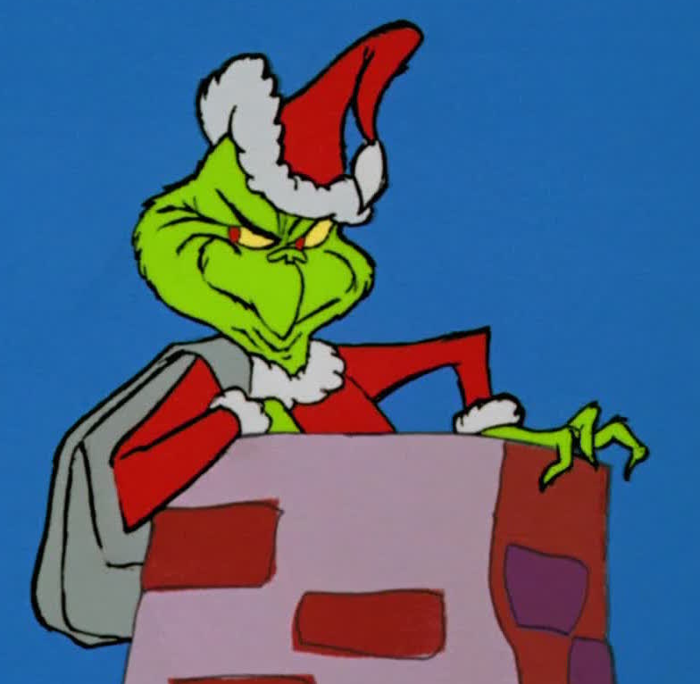
Christmas Traditions
We would go out to eat and to a movie on Christmas Eve
We opened one gift
We would end our day watching “How the Grinch Stole Christmas”

Slide 3
Christmas only recently became the holiday that it is today
Almost 1500 years the practice of Christmas was not celebrated
Missionaries and monks were the voices of Christmas
Their voices were often the only ones to tell the story of Christ
During this time, some of the most beloved carols were born

Slide 4
“Angels We Have Heard on High”
This old carol captures the events in Luke 2
Music was a part of the Lord’s entrance into the world
Song of Mary; wisen men worshipped; heavenly host praised God in the presence of shepherds

Slide 5
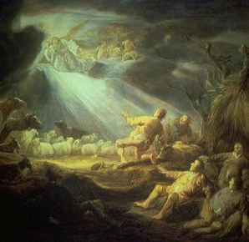
The Story
This carol’s origin is unknown
The first known time this carol was sung was in the 19th century in France
The first published version of the song was in French in 1855
“Gloria in excels is Deo” means “Glory to God in the Highest”

Slide 6
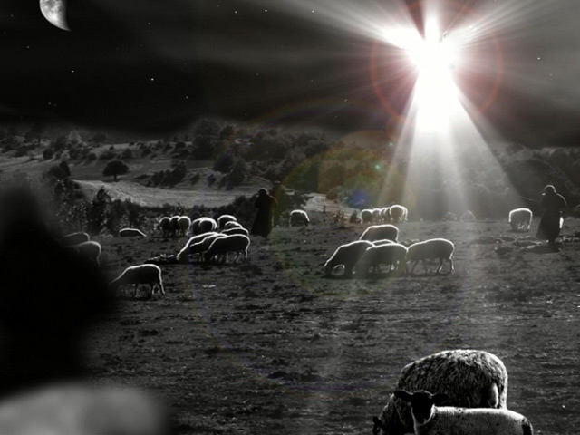
The Song
The carol’s verses looks at the angel’s visit with the shepherds
Why did angels appear to humble shepherds?

Slide 7
We shouldn’t be surprised of the angels visit with the shepherds
Bible clearly teaches that angels are ministering servants of God (Hebrews 1:14)
Angels are interested in us and our salvation
Psalm 91:1; Luke 15:7; Hebrews 1:14; I Peter 1:12
We have much to sing about because of the joy of heaven over our salvation

Slide 8
It’s our job to keep the story alive

