Slide 1
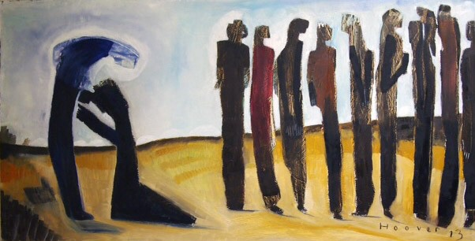
Thankful Life

Slide 2
What does it mean to be a Christian?

Slide 3
“In everything give thanks”
It seems “thanks” is given less
How many “thank you’s” did you hear this week?
How many times did you say it?
Is our gratitude greater than the 10% in Luke 17?
90% of all the lepers in Luke 17 didn’t show gratitude
What percentage of us who don’t express gratitude to God continually?

Slide 4
We give thanks because we remember the disease we once had and know how good it is to be forgiven

Slide 5
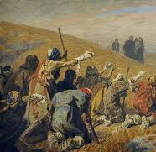
The Lepers
“Now it happened...”
Jesus didn’t personally encounter everyone
To be a leper and have an opportunity is tremendous
Lepers were to keep their distance
They simply and only asked for mercy

Slide 6
“Go show yourselves to the priest”
The procedure with leprosy was to go to the priest (Leviticus 13-14)
The men were to trust in Jesus’ word
All ten asked. All ten believed. All ten obeyed. All ten were healed.

Slide 7
Ungrateful Lepers
What are ungrateful lepers?
Those who are healed and go on living as if nothing happened
All ten were completely and totally healed
Jesus completely changed their life
How did they handle this gracious gift?
Does this ungrateful attitude permeate our churches and culture today?

Slide 8
One Grateful Leper
What are grateful lepers?
Those who are healed and never forget what God has done for them
They see the providence in God by the “now it happened” moments
The one leper was good enough to thank Jesus

Slide 9
We cannot go on living a single day or moment without being grateful for what God has already done

