Slide 1
Thankful Heart

Slide 2
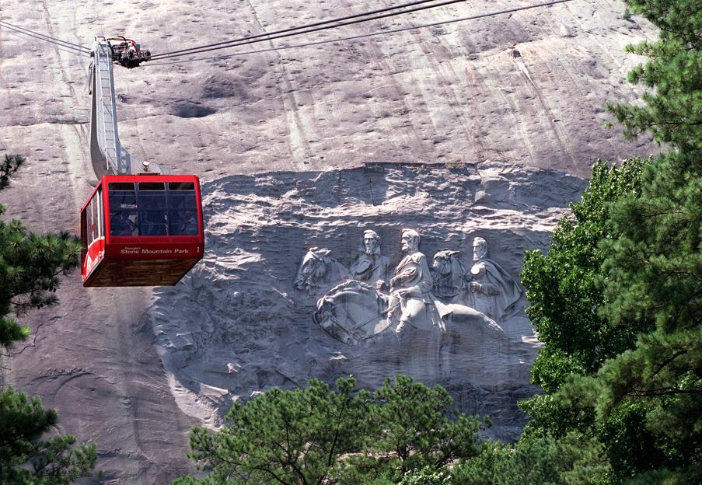
Stone Mountain

Slide 3
I came down the mountain more thankful than I did going up

Slide 4
Ground level living
A challenge for us to be aware of God and His blessings at all times
I think it’s more challenging to be thankful because of our comfortable life
Are we thankful because of the season or because of the Savior?

Slide 5
We have a thankful heart by praising God
“Bless the Lord, O my soul; And all that is within me, bless His holy name” (103:1)
What does it mean to bless the Lord? To praise and lift Him up
What if we began and ended our day with blessing the Lord?
How much different would our life be in between?

Slide 6
We have a thankful heart by remembering God’s benefits
“Bless the Lord, O my soul, and forget not all His benefits” (103:2)
A big difference between forgetting and not forgetting all His benefits
What do you say of a person that forgets good things done for them?

Slide 7
Some benefits in Psalm 103
God forgives all our sins (103:3)
God has not dealt with us according to our sins
God is merciful and gracious, slow to anger, and abounding in mercy
God’s benefits are great

Slide 8
Climbing your own Stone Mountain
People in your past who invested in your life
Our past is people
On top, you are before the Lord
We are reminded of our awesome God and may we live with thanksgiving

