Slide 1
A Thankful Act

Slide 2
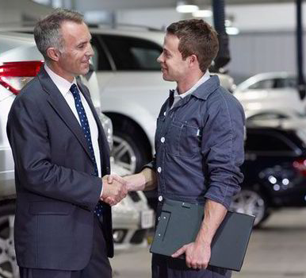
Work harder when appreciated
Survey about gratitude had 80 percent who said they worked harder when hearing thanks
Being appreciated is one of the greatest motivators
Single act of “thank you” carries so much weight

Slide 4
Gratitude flows from God’s presence
Gratitude is seeing the good
Thankfulness comes because of a gift
What about God’s gifts?

Slide 5
We can easily take God’s gifts for granted
We can place more value on things that fade than what is eternal
James 1:17
The more aware we are of God, the more thankful we become

Slide 6
Gratitude grows in humility
If we believe we are owed, we will not be thankful
The more entitled we get the less thankful we become
People who keep getting more and more easily show less gratitude

Slide 7
Remember the ten lepers
Jesus graciously healed them
Only one came back to show a thankful act
Why him?
He demonstrated humility by falling down on his face at the feet of Jesus
His humility led to him being more grateful

Slide 8
Gratitude recognizes imperfections
Are you thankful for all people?
Are you thankful for the people you get along with and the ones you don’t?
Gratitude is in God and not people
“In everything give thanks”
This would include imperfect people and imperfect situations

Slide 9
We can be thankful in everything because of God and His goodness
John 3:16 is still in the Bible if we have a bad day
Romans 8:28 still applies even if it’s not good
Imperfections should not prevent us from being thankful

Slide 11
Extend thanksgiving to others by your thankful acts

