Slide 1
Jesus Teaches About Prayer

Slide 2
How important is prayer?

Slide 3
God, the Father, listens as the one “to whom” we pray (Luke 11:2)
God, the Son, listens as the one “through whom” we pray (Romans 8:34)
God, the Spirit, listens as the one “with whom” we pray (Romans 8:26)

Slide 4
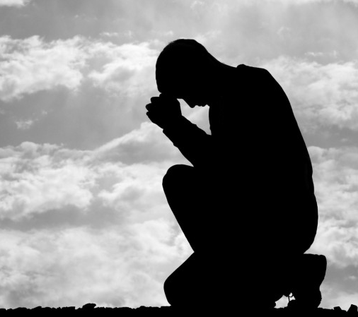
How to Pray
Jesus spoke on prayer with His disciples
His instruction began with “Our Father”
Notice the characteristics in His prayer to the disciples in Luke 11

Slide 5
Greatness of God “Our Father in Heaven”
Glory of God “Hallowed be Your name”
Government of God “Your kingdom come”
Gifts of God “Give our daily bread”
Grace of God “forgive us our sins”
Guidance of God “into temptation”

Slide 6
What to Pray
The Pharisee’s Prayer
He showed no dependency on God
He informed God of his goodness
The Publican’s Prayer
He didn’t soften his words
He was concerned with his relationship with God

Slide 7
When to Pray
He prayed after His baptism (Luke 3)
He prayed before a difficult decision (Luke 6)
He prayed after a long day (Luke 9)
He prayed when he was burdened (Luke 9)
He prayed when he was disappointed (Luke 22)
He prayed when He was dying (Luke 23)

Slide 8
Lord, teach us to pray

