Slide 1
Fishing with Peter

Slide 2
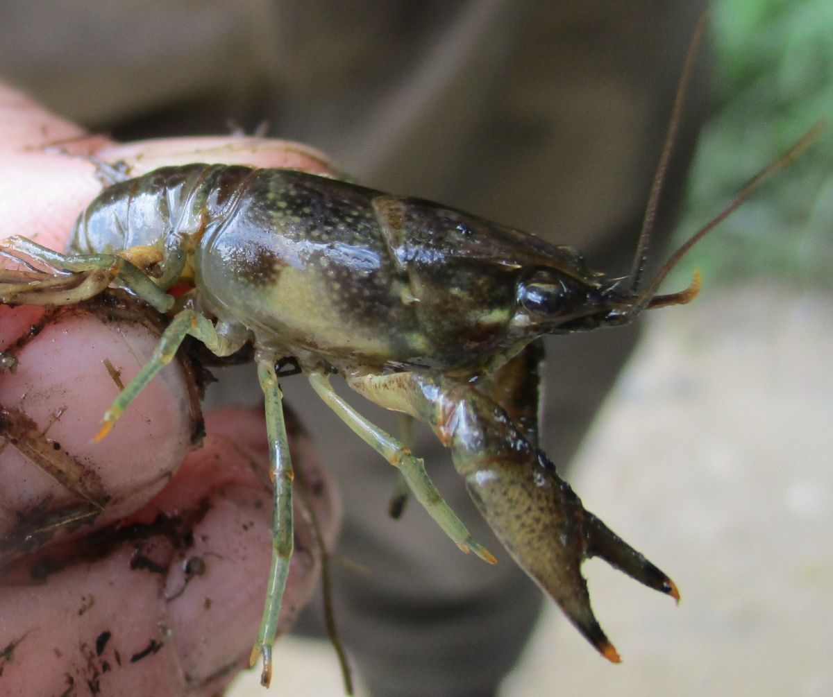
Crickets, chicken liver, crawdads, and chewing gum
“Cast out your line and leave it there. Don’t scare the fish”

Slide 3
I learned the little fish can distract me from the bigger fish
I learned that fish wouldn’t get in trouble if they kept their mouth shut
I learned that it’s worth the wait

Slide 4
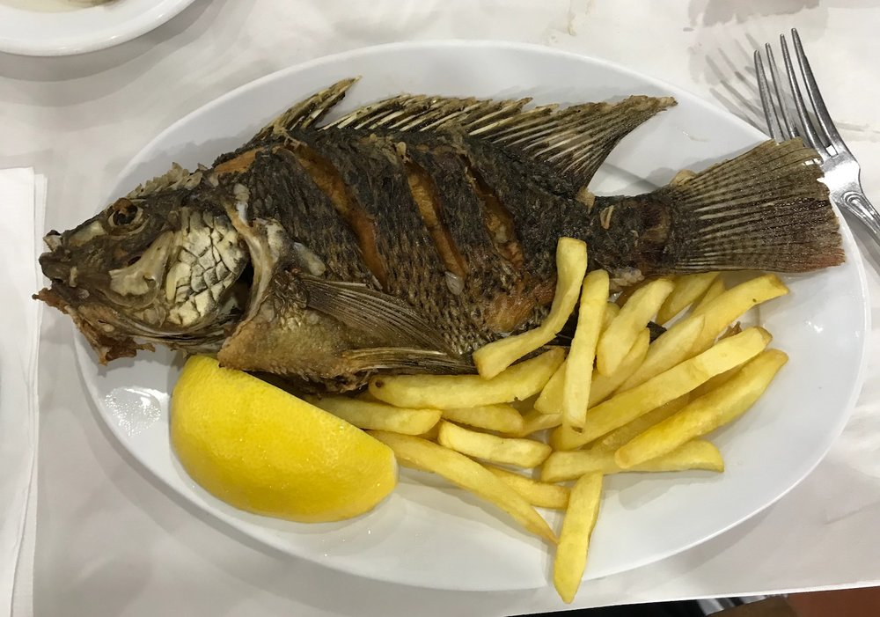
Fishing with Peter
Simon Peter was a fisherman by trade
He and Andrew were heirs to the family business
Sardines, barbels, and musht on the Sea of Galilee

Slide 5
The fish that subjected him
Time had passed since Peter fished
Peter went from casting nets to casting out demons
He went from catching fish to catching people
Peter was asked, “Does your Rabbi (teacher) not pay the temple tax?”
Instead of going into the money box, Jesus instructed Peter to go and catch a fish

Slide 6
The word “subject” means “under authority”
Matthew more concern with Jesus’ cast out words than Peter’s cast out net
This ends with Jesus and not Peter
It ends with the One with authority
Peter subject himself to the Lord and Laws of the Land

Slide 7
The lesson Peter reeled in his epistle
As citizens, we are to submit to the Leaders of the Land (I Peter 2:13)
As workers, we are to submit to the Leaders of the workplace (I Peter 2:18)
As spouses, we are to submit to the Leaders of the home (I Peter 3:1)
Peter caught the lesson of responsibility

Slide 8
God wants us all to under authority

Slide 9
What have you reeled in this morning?

