Slide 1
Godly Mother

Slide 2
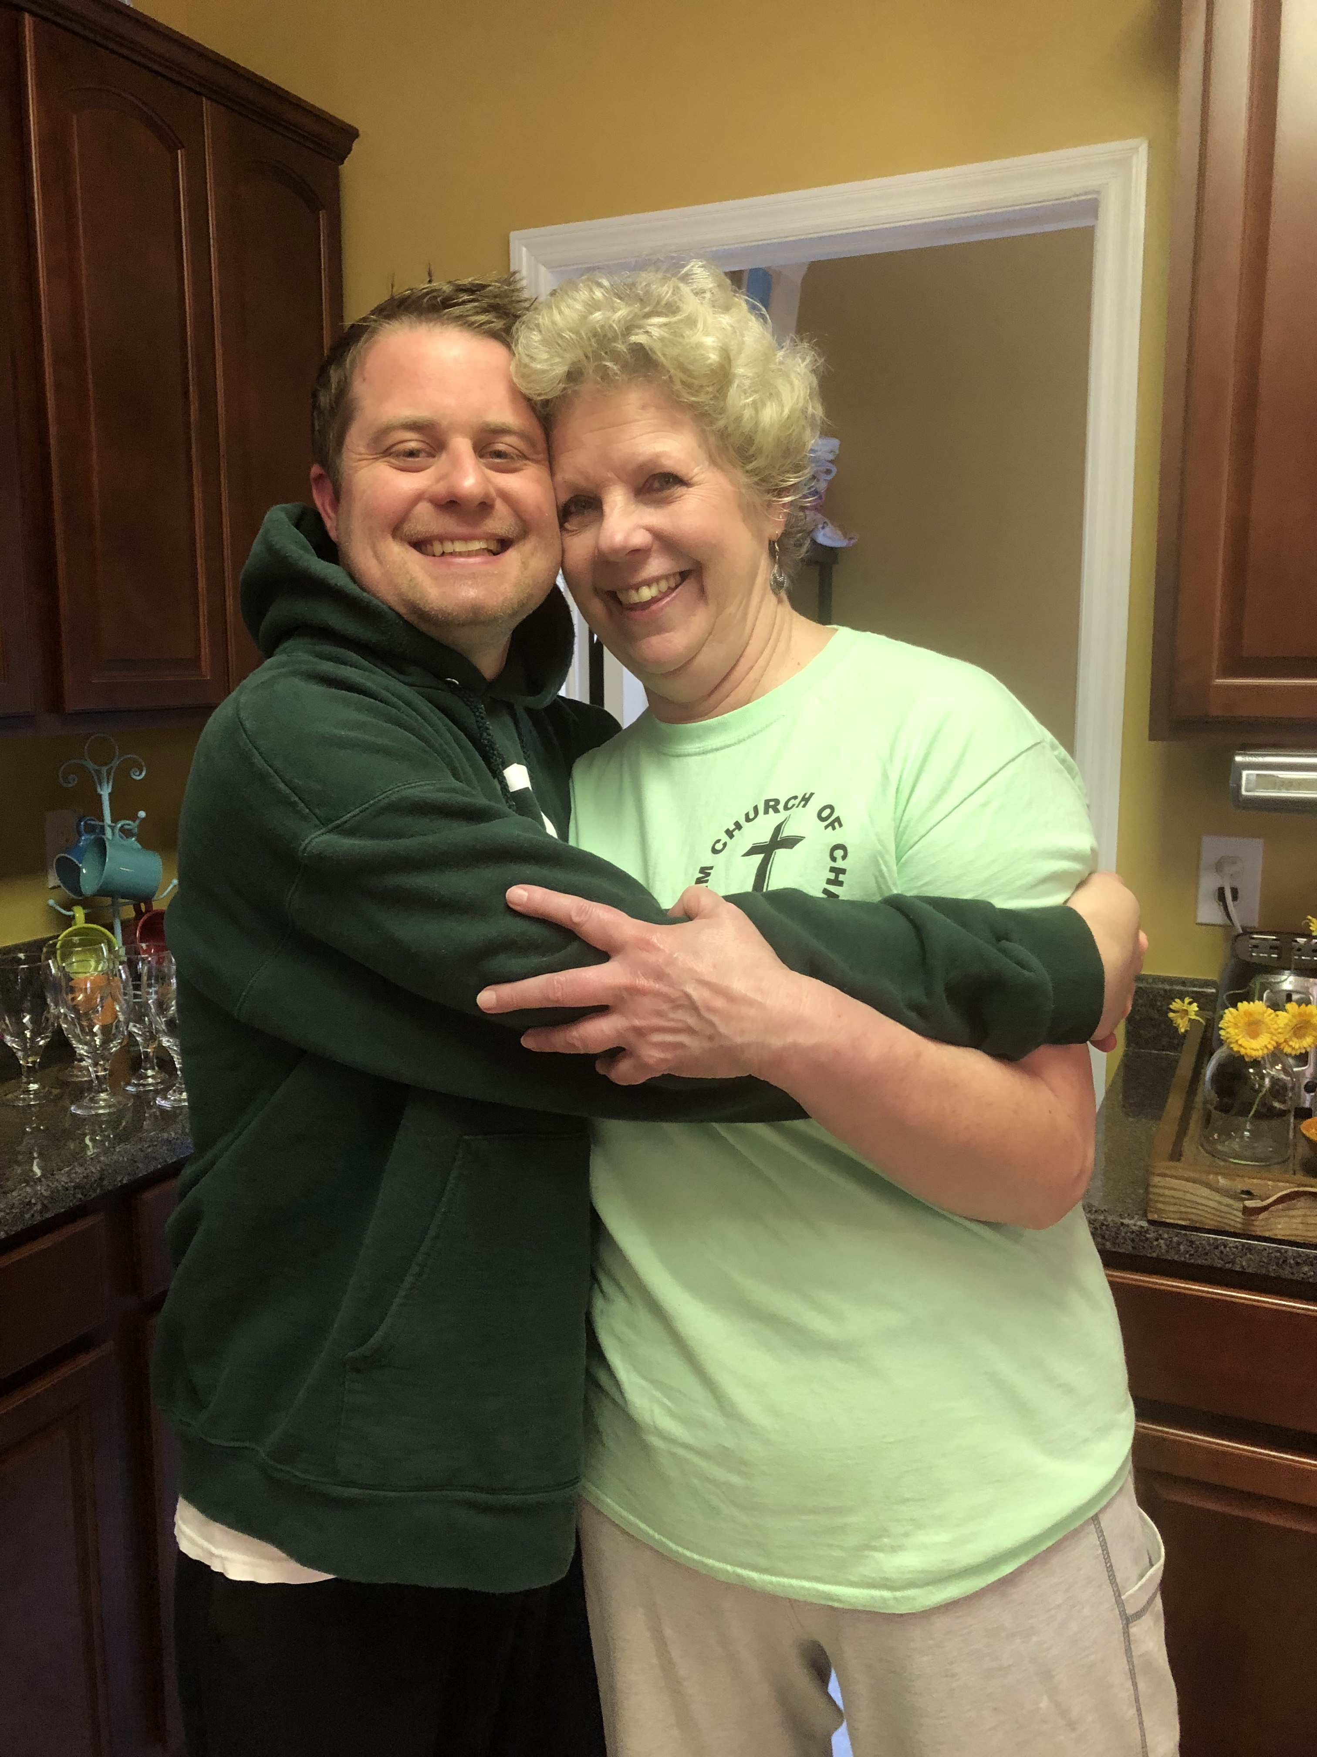
Growing up, I thought my mother was like other mothers
That somehow all mothers had made a pact to be the same
I quickly realized that to be untrue.
Children from broken and divorced homes
Children in someone else’s care
We cannot choose our parents
If we are blessed to have a godly mother, it’s priceless

Slide 3
The time of Judges
After the days of Joshua, the Israelites practiced idolatry (2:11-12)
The Lord punished the people
They would cry out to Him and Hod brought forth judges to deliver them
A same rebellious cycle throughout judges

Slide 4
During this difficult time, an answer was born
The born answer came from a godly woman

Slide 5
Love for her husband
The book of first Samuel opens up into the home Elkanah
He was from Ephraim and a descendant of Levi
He had two wives
Peninnah had children
Hannah had no children

Slide 6
Polygamy was not a part of God’s will but it was practiced in early Israel
Hannah longed to be a mother
She worshiped with her husband at Shiloh
This was done annually (1.7)
They worshiped God together, which helps in handling adversity

Slide 7
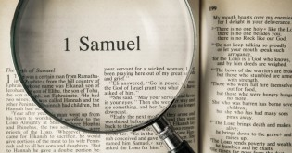
Love for God
Hannah brought her burden to the Lord
Notice: the burden of a closed womb brought her closer to the Lord
It’s Hannah that is highlighted in the Scriptures and not Peninnah
I believe the same holds true today (James 1:2)

Slide 8
Hannah did the one thing she could do- prayed
She “prayed to the Lord and wept in anguish” (1:10)
She poured her soul out before the Lord
Hannah poured her soul and the unnamed widow poured her oil out
Do we see a common theme?

Slide 9
Hannah made a vow to God
I Samuel 1:11
She asked for a son so she could give him back to God
She didn’t ask for children but one son
A son for the Lord
Her strong devotion was mistaken by the priest as someone drunk
Hannah had poured her sorrow and not wine

Slide 10
The change in Hannah after her prayer
She began her prayer with bitterness in her soul and she ended it with no longer sad
She gave God her burden and left it with Him
We will give God our burden put still hang to it
2 Peter 5:7

Slide 11
Love for her home
Hannah bore a son
Samuel was born out of a prayer
Hannah connected to baby Samuel
Hannah kept her vow to God
God rewarded Hannah later with three boys and two daughters

Slide 12
It’s not my child but God’s child

