Slide 1
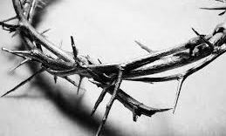
A Suffering Servant, Soldiers, Simon

Slide 2
Imagine if going to heaven was different...

Slide 3
Praise be to Jesus Christ
Jesus' sacrifice was once and for all
Romans 6:10
There is no need for Jesus to die again or us to die for our sins
How much easier for us to believe, obey, and follow Him?

Slide 4
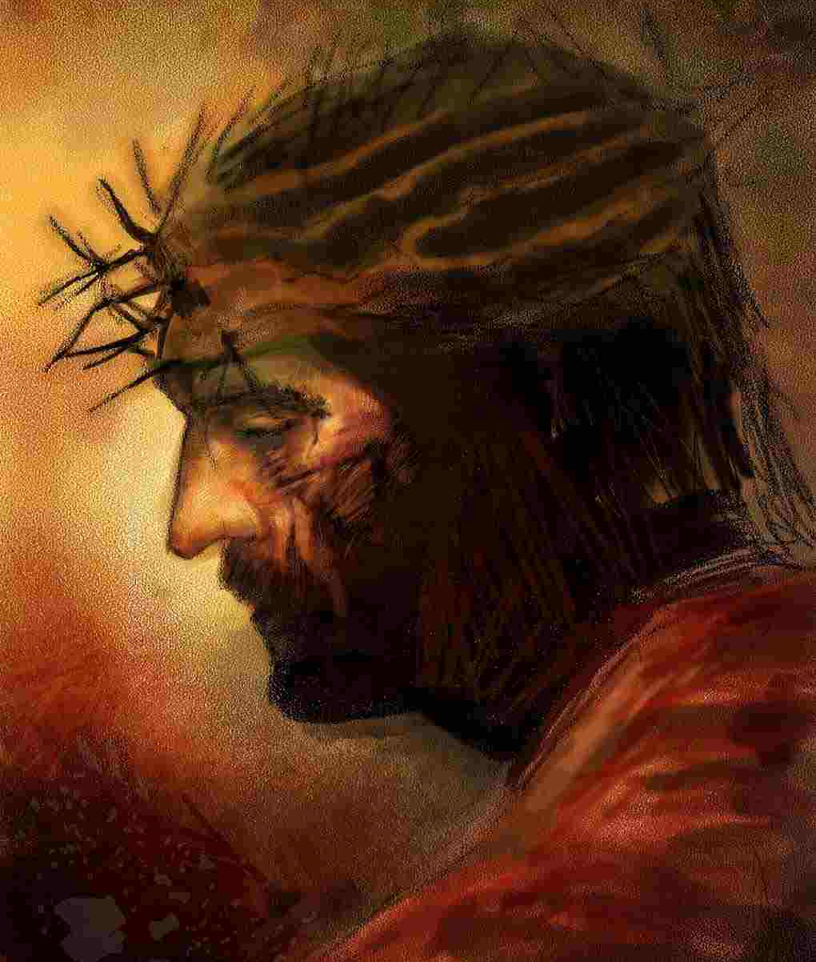
A Suffering Servant
It is worth reading and reflecting the last hours before the cross
Jesus was flogged and humiliated

Slide 5
Flogging was designed to inflict incredible pain and leave the victim with only enough strength to carry their cross
"I gave My back to those who struck Me" (Isaiah 50:6)
Jesus never begged for mercy
He did not fight back or go down swinging
He was wounded for our sins (Isaiah 53:5)

Slide 6
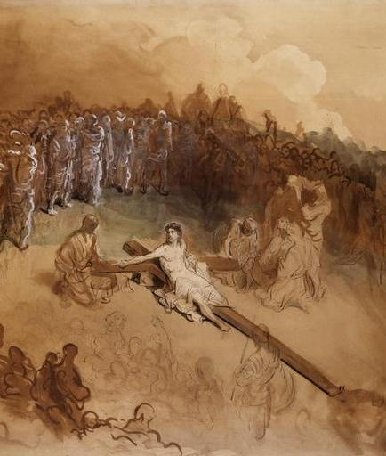
Soldiers
Soldiers led Jesus into the courtyard of the palace and they called together a whole cohort
They stripped Him, left Him exposed and vulnerable
Difficult to imagine

Slide 7
Why did the soldiers do these things?
Why did they commit such evil?
Soldiers symbolize the evil within us as people
Ordinary people can do some extraordinary and awful things
Right ideology, authority, and desensitization can create monsters
The soldiers remind us of the evil we are capable of doing

Slide 8
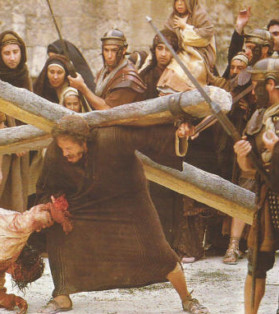
Simon
Simon happened to be in the right place and right time
He was impacted by this event
"Alexander and Rufus"
Years later Alexander and Rufus were known by Christians (Romans 16:13)

Slide 9
Sometimes we think wrong place at the wrong time but that wrong event shaped us
We wouldn't want to redo it but we wouldn't take anything for it

Slide 10
Three stand before us
Suffering Savior
Soldiers
Simon of Cyrene

