Slide 1
The Gift of Choice in the Next Life

Slide 2
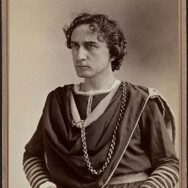
Edwin Thomas
Master of the stage
He performed Hamlet in New York for 100 consecutive nights
He had two brothers who were actors
His brother John assassinated President Lincoln in Ford’s Theatre in 1865
Edwin was never the same after that
He never would until the day he chose to help

Slide 3
Edwin and John Booth
Same father, mother, profession, and love for the arts
One chooses to save life and the other to take it
How?
Abel and Cain; Abraham and Lot; Peter and Judas

Slide 4
God allows us to make our own choices
We have the freedom to choose where we spend eternity

Slide 5
The gift of choice in the next life in JESUS PREACHING

Slide 6
The gift of choice in the next life in JESUS’ DEATH

Slide 7
We’ve all made some bad choices
One great choice for eternity offsets thousands of bad ones
The choice is yours

Slide 8
How can two brothers be born of the same mother and...
How can two robbers see the same thing but...
I don’t know
God allows us to choose

