Slide 1
CONSIDERATION
Ruth
Recipe to Remember

Slide 2
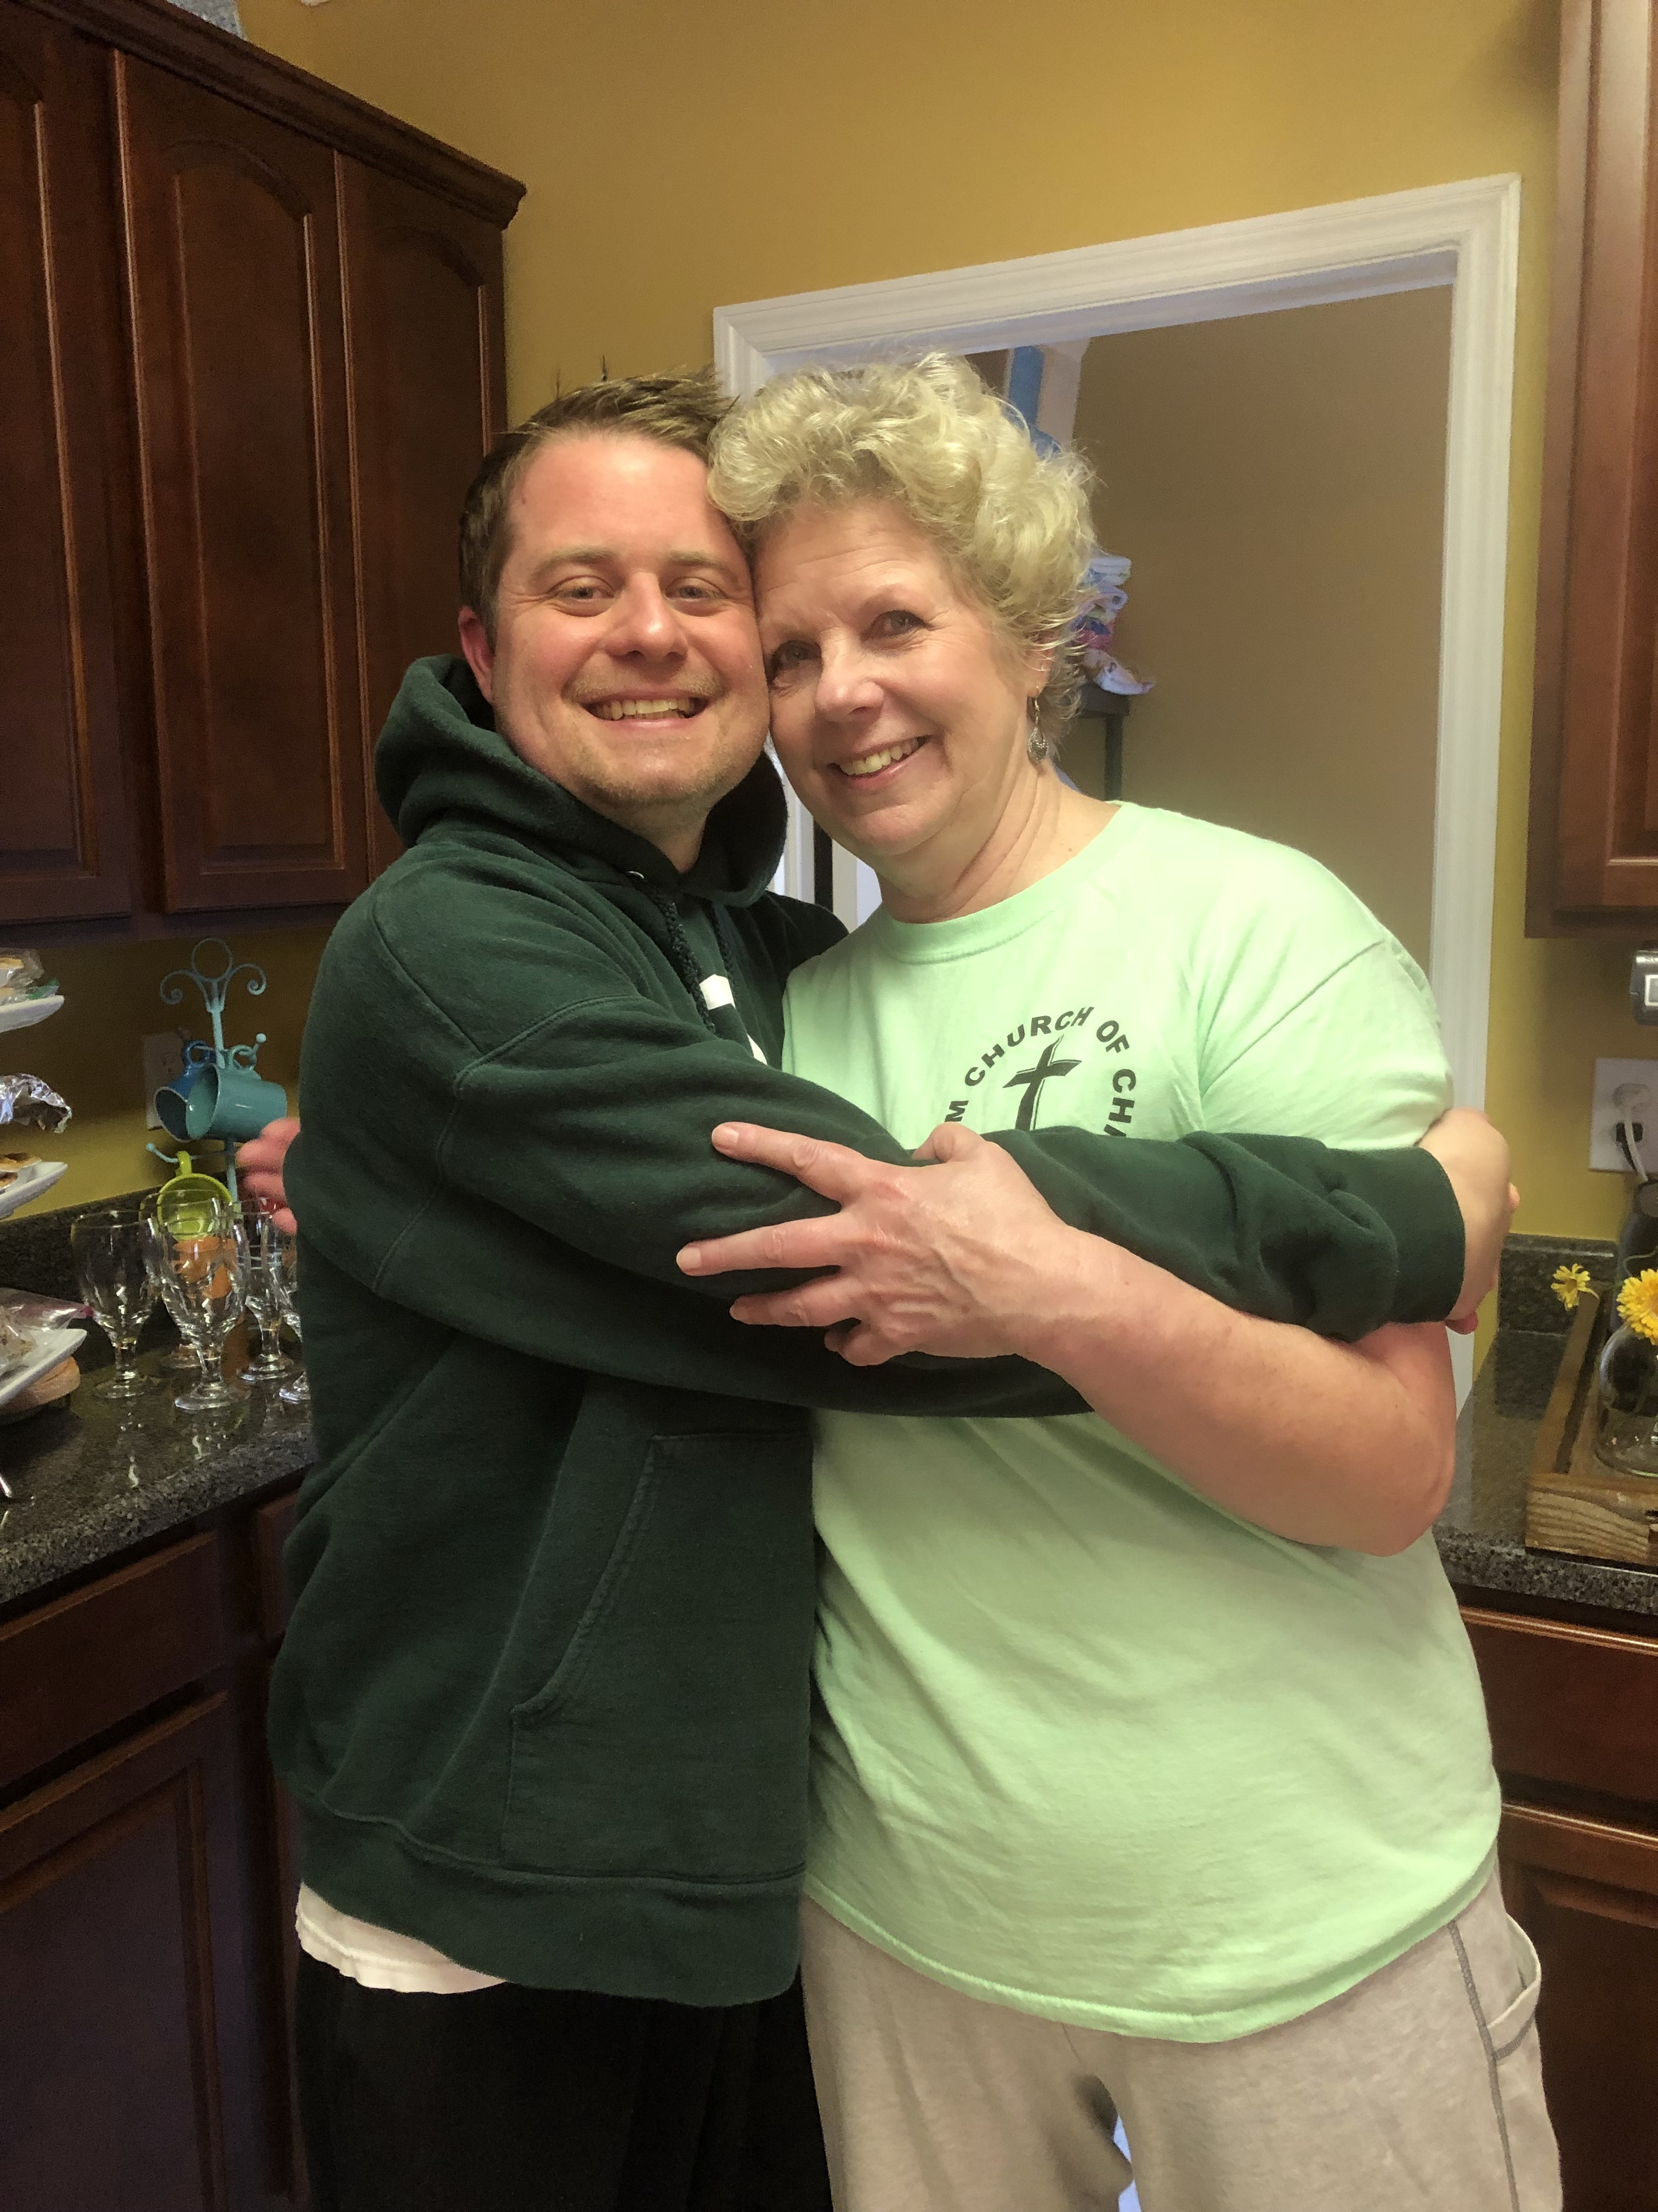

Slide 3
A recipe worth remembering has nothing to do with milk, eggs, and butter
It has everything to do with a godly character
Ruth’s life is a recipe for us to remember

Slide 4
First Ingredient is Consideration
“The Lord repay your work, and a full reward be given you by the Lord God of Israel under whose wings you have come for refuge” (2:12)

Slide 5
Ruth is known as the “Moabite” (2:2, 2:6) and “foreigner” (2:10)
The tragedy of a famine brought Naomi into Ruth’s life
What if no famine in Bethlehem?
The servants of Boaz referred to Ruth by nationality
Consider the People

Slide 6
There is no denying human decisions and actions
Naomi made the decision to return home
Ruth made the decision to stay with her
Naomi had brought in outsider into the God of Israel
The tragedy of death brought Boaz and Ruth together
Accidents and tragedies happen
Consider the people
Consider the People

Slide 7
Ruth and Naomi arrived in Bethlehem at the barley harvest
Ruth takes advantage of a generous provision in the Law
God cares for the poor, needy, and stranger
Of all the fields, it so happened that Ruth went to the fields that belong to Boaz
Naomi saw what Ruth thought was a coincidence as God’s care
Do you consider your place?
Consider the Place

Slide 8
Consider the people in your life as an example of God’s care
Consider the place you are at as an example of God’s care

