Slide 1
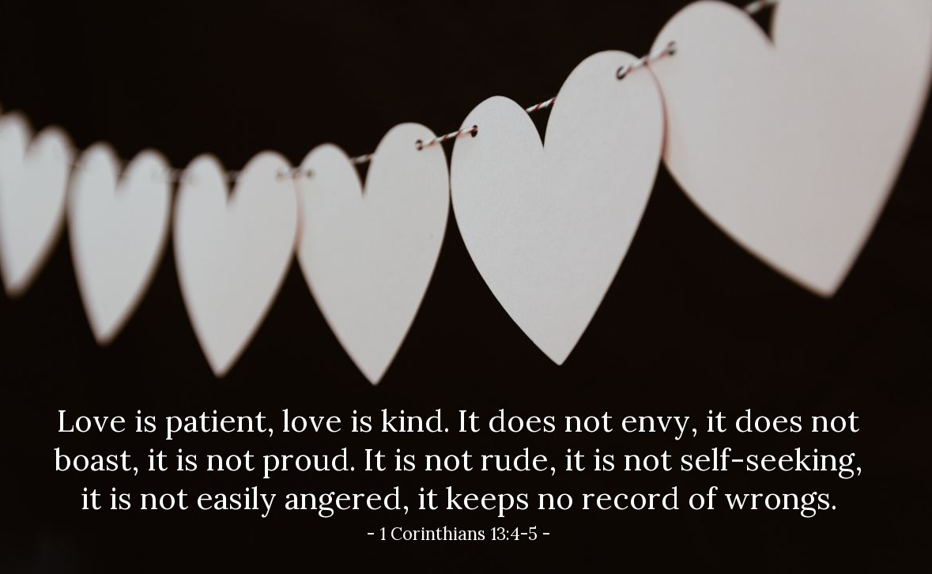
A Great Example of Better Love

Slide 2
Love keeps no record of wrongs
(I Corinthians 13:5)

Slide 3

Forgiveness is the best example of love that keeps no record of wrongs
Jesus practiced this on the cross (Luke 23:34)
Jesus preached this (Matthew 6:14-15)

Slide 4
“Lord, how often shall my brother sin against me, and I forgive him? Up to seven times?”
(Matthew 18:21)
“I do not say to you, up to seven times, but up to seventy times”

Slide 5
Parable about Forgiveness
(Matthew 18:23-35)
Certain king settled accounts with his servants (18:23)
One owed “ten thousand talents”
King ordered his family and possessions to be sold
Servant begged the king and the king forgave the servant of his debt

Slide 6
It takes the love of God to forgive
When God loving forgives, He doesn’t rub it in but He rubs it out
The forgiven servant in time met someone who owed him a small debt
The servant didn’t do to what was done to him
He kept a record of wrong (debt)

Slide 7
Is our love different?

Slide 8
Practical ways to love enough to forgive
Recognize what your motive for forgiveness should be
Remember what forgiveness is
Realize what forgiveness is not

Slide 9
True love keeps no record of wrongs

