Slide 1
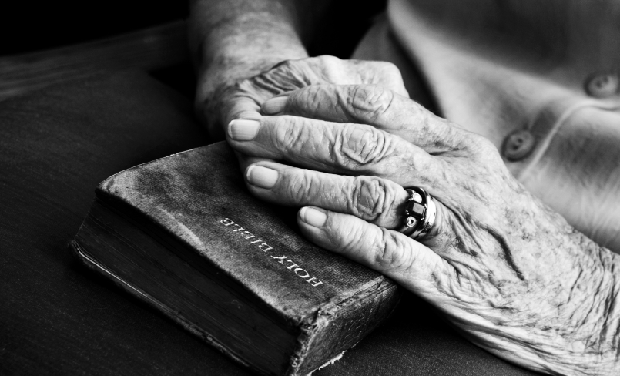
Holding on to God’s Unchanging Hand

Slide 2
What comes to mind when hearing “hand holding”?
Do you think of the first love of that boy/girl?
Do you think of your parents?
Do you think of the perfect little hands of your newborns?

Slide 3
What about the infamous words of Jennie Wilson? “Build your hopes on things eternal, hold to God’s unchanging hand” “Under the mighty hand of God” (I Peter 5:6)

Slide 4
The Blessing of holding God’s Hand
God’s Hand represents commitment
It’s God, Himself who has said, “I will never leave you nor forsake you” (Hebrews 13:5)
What about Jesus’ last words in Matthew’s gospel?
God’s Hand is a committed hand so we can count on Him
“If by earthly friends forsaken, still more closely to Him cling”

Slide 5
God’s Hand is a blessing because it’s a compassionate hand
Jesus showed compassion on earth by who he touched
He touched lepers (Matthew 8)
He fed the poor (Mark 8)
He restored life to a child by holding her hand (Luke 8)
He lovingly dismissed a woman caught in the act of adultery (John 8)
Every good and perfect gift comes from the compassionate hand of God

Slide 6
God’s Hand is a blessing because it’s a controlled hand
God’s Hand founded the world (Jeremiah 32:17)
God’s Hand freed the Israelites from Egyptian control
His Hand continues to save (I Peter 5:6)

Slide 7
The Benefits from holding God’s Hand
One benefit is security (Isaiah 41:10)
Security that comes from a relationship from the Blood of Jesus
Not living in fear can only happen if He is our God

Slide 8
Another benefit is support
“When your journey is completed, if to God you have been true. Fair and bright the home in glory, your enraptured soul will view”
We have God support beyond our end on earth
When others walk our, God walks in
When other let go, God holds on
God’s support is still found in death (Luke 16.22)

Slide 9
The Bond with holding God’s Hand
We can live confidently with what God has said and done
We can live with conviction because of what God has said and done

Slide 10
Let us put our concerns, worries, fears, hopes, dreams, families, goals, and relationships in God’s Hand

