Slide 1
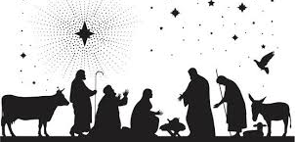
Those touched by His birth

Slide 2
How well do you know the story?

Slide 3
1. Where did the wise men from the East find Jesus?
Manger
House
Stable
We don’t know

Slide 4
B (Matt. 2:11)

Slide 5
Where was Joseph from?
Bethlehem
Jerusalem
Nazareth
We don’t know

Slide 6
A (Luke 2:3-4)

Slide 7
If we can get the story wrong with the birth of Jesus, what about the story in matters of doctrine or practice?

Slide 8
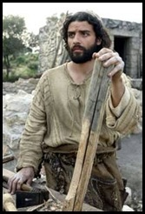
Joseph’s Silence
What was Joseph thinking when he found out that Mary was with child?
“But while he thought about these things” (Matthew 1:20)
He thinks about these things and the Scriptures are silent

Slide 9
Even though the Scriptures are silent, I don’t see Joseph silent
Joseph was touched in a dramatic way by the birth of Jesus
His world was forever changed
He listened and obeyed

Slide 10
Joseph’s Perspective
Matthew 1:18-19
Joseph was a just man betrothed to Mary
Betrothed-an engagement equal to marriage
Most couples have plans and dreams in engagements

Slide 11
Something scandalous and shocking happened
Joseph’s betrothed wife was found with child
Joseph knew that the child was not his
Joseph loved Mary and he didn’t want to make a public example
He made this decision before an angel of the Lord appeared to him
What would justice require for adultery in Joseph’s mind?

Slide 12
Joseph to bring Mary to the priest
Numbers 5:16-22
This required a curse, public shame, and bear her guilt
Joseph a just man showed mercy

Slide 13
“Behold an angel of the Lord appeared” (Matthew 1:20)
What Joseph had thought was nothing like what God had planned

Slide 14
A silent but powerful point
Most of us have stood in a sense where Joseph was at
Stood in a place where we are caught between what God says and what makes sense
You follow God only to wonder if this is the right way because of difficult the way is
Things don’t turn out like you thought

Slide 15
We know what Joseph did
Matthew 1:24
He obeyed
He didn’t let his confusion or lack of fully understanding to disrupt his obedience
He didn’t know everything
He did what he knew

Slide 16
What about us?

