Slide 1
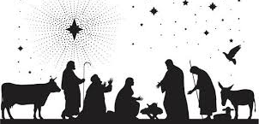
Those touched by His birth

Slide 2
How well do you know the story?

Slide 3
The little drummer boy met Jesus in a
Manger
Stable
House
None of the above

Slide 4
D. No drummer boy

Slide 5
Where do we find the story of Jesus’ birth?
Matthew
Mark
Luke
John

Slide 6
A and C

Slide 7
If we can get the story wrong with the birth of Jesus, what about the story of doctrine or practice?

Slide 8
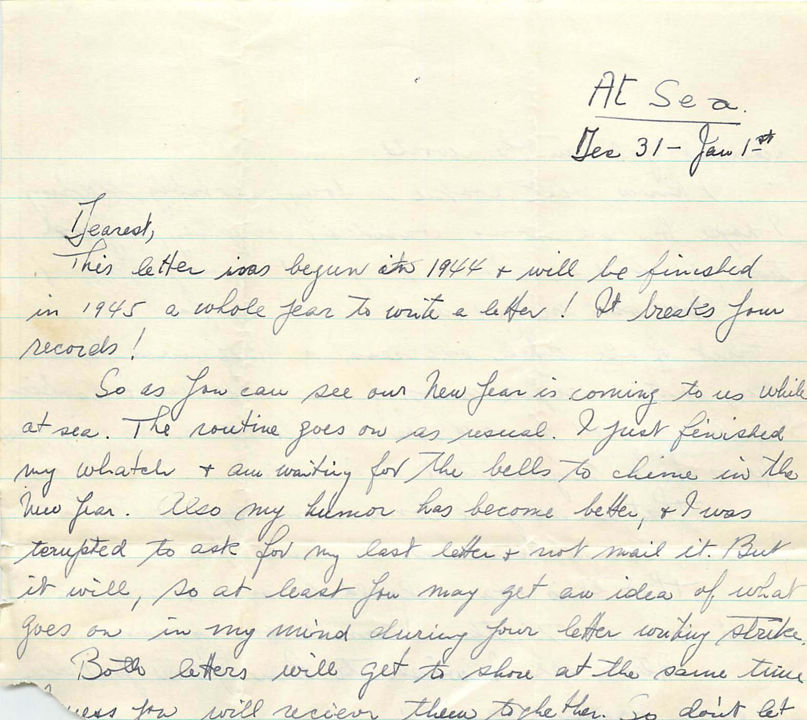
New Year’s letter written to a preacher

Slide 9
What a contrast yo the next person touched by the Lord’s birth
This person was moved to worship
She was highly favored by God
She was the one prophesied over 700 years ago by Isaiah (7:14)

Slide 10
“And having come in, the angel said to her, ‘Rejoice, highly favored one, the Lord is with you; blessed are you among women!” (Luke 1:28)

Slide 11
Mary’s song

Slide 12
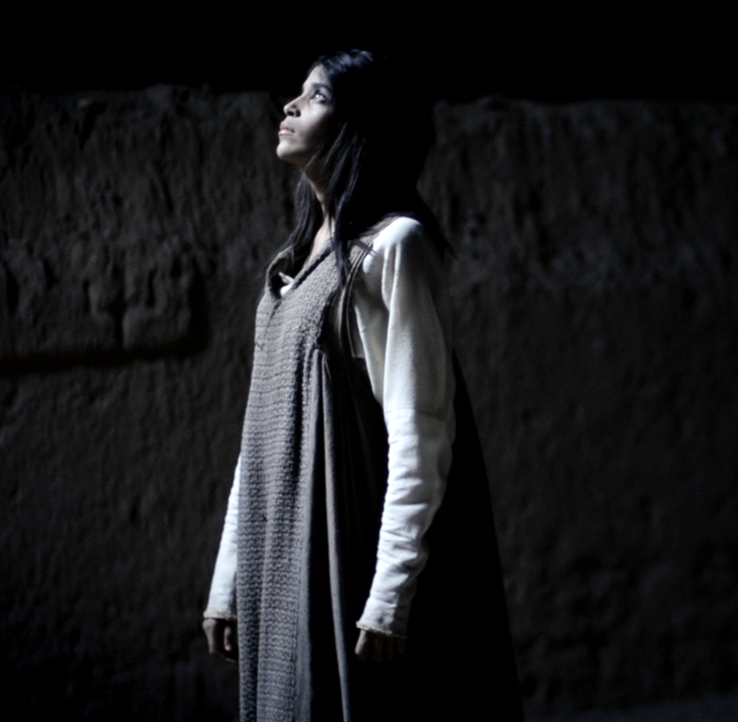
The Announcement
An angel appears suddenly to share God’s plan with a woman named Mary
Mary’s Name in Hebrew means “bitter”
Mary’s your life had bitter hardship
Her hometown was in the poor district of Galilee
The hardship of being with child when only betrothed

Slide 13
Mary was a virgin when Jesus was miraculously conceived in her womb
Mary questioned how it could be since she had not known a man (Luke 1:27)
One of the points of a betrothal was to demonstrate fidelity and faithfulness
Mary’s tremendous young faith (Luke 1:38)

Slide 14
Mother of Jesus came at a cost
The process of carrying and delivering a baby
How would Joseph respond?
What would her family and community think?
There is no evidence of Mary second guessing, questioning, or complaining
“Let it be to me according to your word” (Luke 1:38)

Slide 15
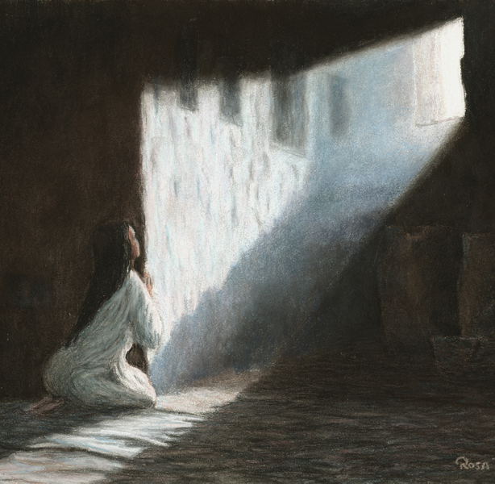
The Act of Worship
Mary hurried over the hilly country to visit with Elizabeth
Elizabeth immediately responded to Mary’s voice
Mary replied with prophetic words
Her song is known as the “Magnificat”

Slide 16
The song is of unspeakable joy
It bears a strong resemblance of Hannah’s song with the birth of Samuel
Mary’s song is filled with language of the messianic hope, scriptural language, and a reference to the covenant of Abraham

Slide 17
My soul magnifies the Lord | I Samuel 2.1 Psalm 35.9
And my Spirit has rejoiced in God my Savior | Isaiah 12:2
For He has regarded the lowly state of His maidservant | I Samuel 1:11
For He who is mighty has done great things for me | Psalm 126:3
His mercy is on them who fear Him from generation to generation | Psalm 103:11

Slide 18
He has shown strength with His arm | Psalm 89:13
He has scattered the proud in the imagination of their hearts | Psalm 89:10
He has put down the mighty from their thrones and exalted the lowly | I Samuel 2:6-8
He has filled the hungry with good things | Psalm 107:9
He has helped His servant | Psalm 105:6-9

Slide 19
God is the one Mary magnifies

Slide 20
Does the same story move you to worship?
The birth, life, and death of Jesus should led us to a regular habit of worship

