Slide 1
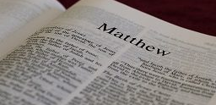
Helping Jesus

Slide 2
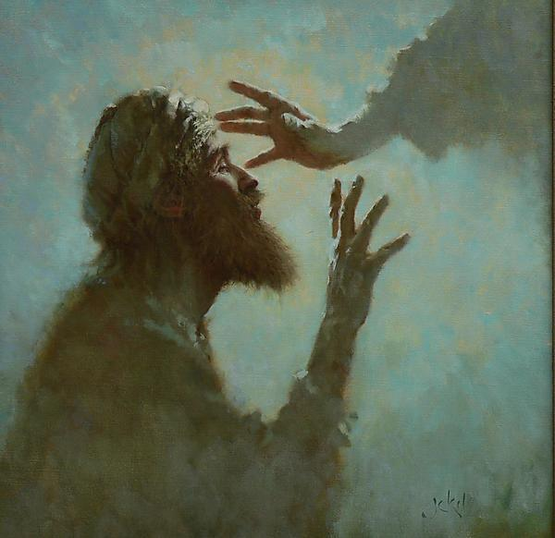
Jesus was favorable towards service
Mark 10:45
There is nothing convenient about giving your life
He served sinners
He served the sick
He served the starving

Slide 3
Would you help Jesus?

Slide 4
Helping Jesus is meeting the needs of others (Matthew 25:40)

Slide 5

Service of Support
“For I was hungry and you gave Me food” (25:35)
The need is hunger
Have you ever met someone who was hungry?
How are we to serve?

Slide 6
“You gave me food”
Who gives food? YOU
Nehemiah fed 150 people from his own table daily (Nehemiah 5)
Participating by serving to meet the needs of others
You gave me food
We can feed Jesus by feeding those who are hungry

Slide 7
Service of Satisfaction
“I was thirsty, and you gave Me drink”
What is the need? Thirst
How are we to serve?

Slide 8
“You gave me drink”
Matthew 10:32
This service can be as simple as a cup of cold water, bringing someone to worship, visiting with someone, and letting someone know you are mindful of them
Participating by serving to meet the needs of others
We satisfy Jesus by giving a drink to those who are thirsty

Slide 9
Service of Shelter
“I was a stranger, and you invited Me in”
What is the need? Shelter
How are we to serve?

Slide 10
“You invited Me in”
Participating by serving to meet the needs of others
Rahab provided shelter for the two spies
Natives on the island of Malta provided shelter for 276 people
Lydia offered shelter from night to Paul and his traveling companions
Shelter is as simple as rest for a weary traveler, cool spot on a hot day, and a warm place on a cold night

Slide 11
Service of Clothing
“I was naked and you clothed Me”
What is the need? Naked or lack of clothing
How are we to serve?

Slide 12
“You clothed Me”
Participating by serving to meet the needs of others
Clothing can show emotions
Lack of clothing expresses a need for help
We clothe Jesus by clothing those in need

Slide 13
Service of Comfort
“I was sick and you visited Me”
What is the need? Sickness
How are we to serve?

Slide 14
“You visited Me”
Participating by serving to meet the needs of others
We have not one but two shoulders to bear burdens
“Bear one another’s burden” (Galatians 6:2)
Jesus didn’t say to make well or fix but “visit”
We visit Jesus by visiting the sick

Slide 15
Service of Companionship
“I was in prison and you came to Me”
What is the need? Prison
How are we to serve?

Slide 16
“You came to Me”
Participating by serving to meet the needs of others
Providing companionship to Jesus when we provide the same to prisoners

Slide 17
Will you participate in helping Jesus by your service towards others?

