Slide 1
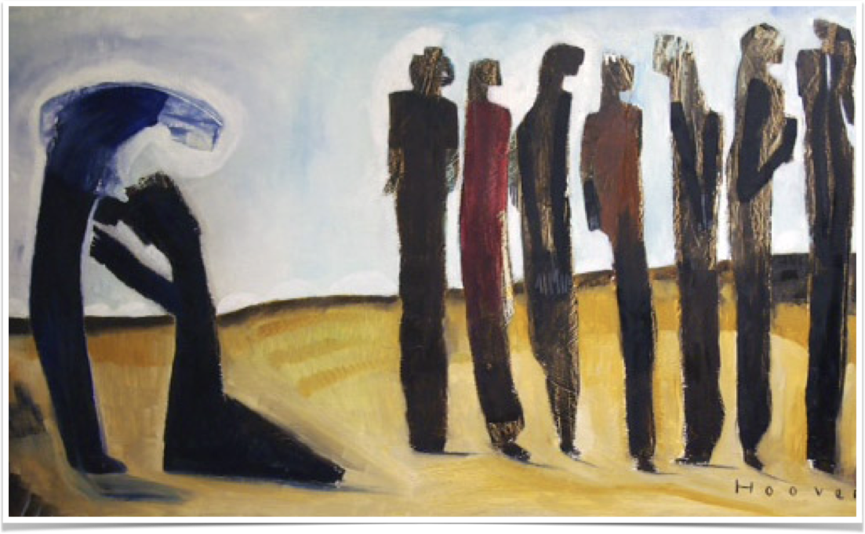
Ongoing Thanks

Slide 2
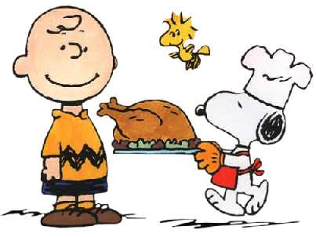
Thanksgiving Forecast

Slide 3
What does it mean to be a Christian?
Does gratitude come to mind?
"In everything give thanks" (I Thessalonians 5:18)
Thanks is becoming less
90 percent of the lepers were ungrateful in Luke 17

Slide 4
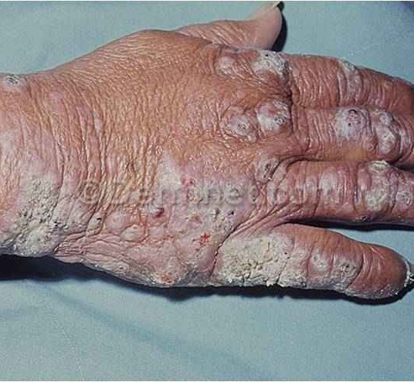
The Lepers
To encounter Jesus on earth was a blessing
Lepers were compelled by law to keep their distance
Jesus said to go to show yourselves to the priest (17:14)

Slide 5
All ten asked, believed, obeyed, and received restoration
But not all had the faith to live

Slide 6
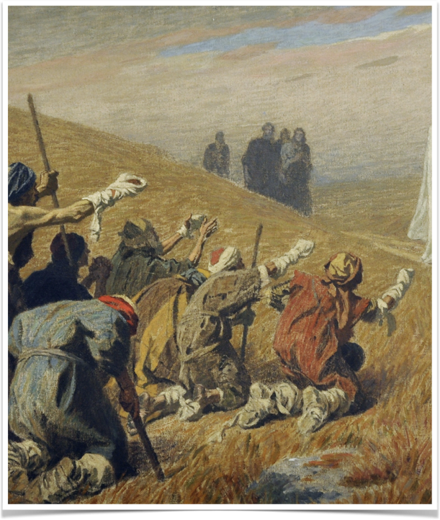
Ungrateful Lepers
What are ungrateful lepers?
Someone healed but goes on living as if they never had the disease

Slide 7
Those thankless nine went on with life as if they never met Jesus
Do they represent people today?
Do we go on with our life as if the blood of Jesus means nothing?
Those in Christ have been cured from the greatest disease

Slide 8
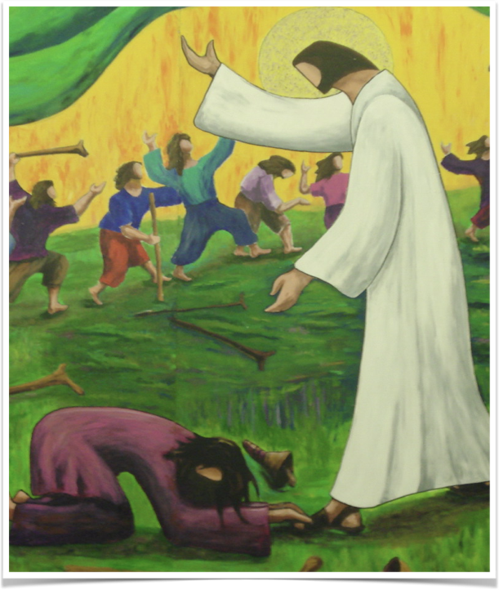
Grateful Leper
What are grateful lepers?
Those healed and never forget
The one leper remembered the One responsible

Slide 9
Be thankful and remember what Jesus has done for you

