Slide 1
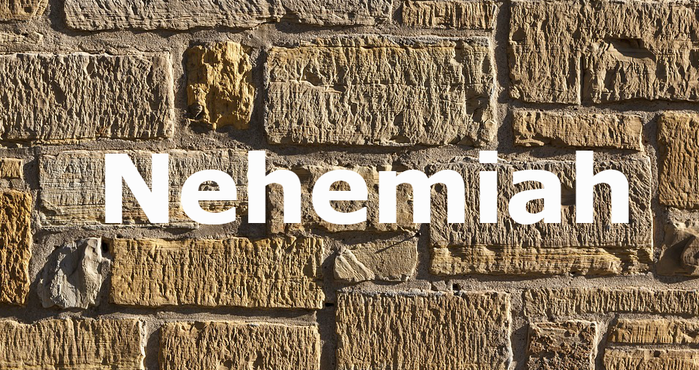
Stone of Obligation

Slide 2
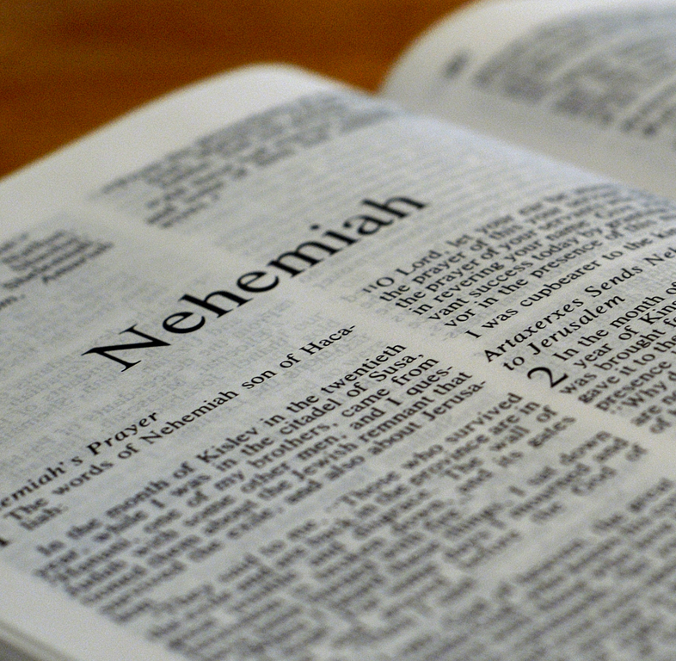
What if we lived according to the words we pray, preach, and sing?
What happens after the final “Amen” and the service ends?
Do we realize the obligation from worship?
If we are active in worship, we did to live according to what we say and agreed

Slide 3
The Stone of Obligation

Slide 4
Their Testimony
84 people placed their seal on the covenant
The list included priests, Levite’s, leaders, wives and their children
The seal was a big deal because it involved an oath before God (10:28-29)
Numbers 30:2

Slide 5
Our words before the Lord should be a big deal as well
2 Timothy 2:19
One of the necessary steps is to use our mouth to confess Jesus before others (Matthew 10:32-33)

Slide 6
What did they obligate themselves to?
The gave an oath to walk in God’s Law (10:29)
They gave their word to observe and do all the commandments of the Lord (10:29)
They would separate themselves from people of the land (10:30-31)

Slide 7
We have made a commitment to the Lord if we are a Christian

Slide 8
Their Time
It’s one thing to give your word
It’s another to give your time
They gave their time to God on the Sabbath by not buying on it (10:31)
They would observe the Sabbatical year (10:31)
This required their time

Slide 9
What about our time on the Lord’s day?

Slide 10
Their Tithes
Beginning in Nehemiah 10:32, the phrase “house of our God” is mentioned about 9 times
This referred to the temple
God’s house needed to be supported by Gods people
The obligated themselves to giving the temple tax (10:32-33). We do give to the work of the ministry today

Slide 11
They obligated to give to the wood offering
They obligated to give God the first and best. We need to give God the first (Matthew 6:33)
The “tithes” were a tenth of the goods to the Levites (10:38)
They gave purposely by knowing what to give (10:32). We need to give with purpose (2 Corinthians 9:7)

Slide 12
They gave sacrificially
Firstfruits of the ground (10:35)
Firstfruits of all the fruit of all the trees (10:35)
Firstfruits of our sons and our cattle (10:36)
Firstfruits of our dough (10:37)

Slide 13
What about us?

Slide 14
How committed are you in following Jesus?

