Slide 1
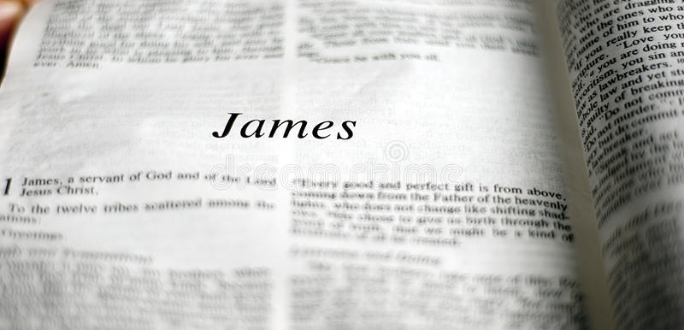
Dynamic Faith

Slide 2
What adjective would you use to describe your faith?

Slide 3
What is faith?
Mentioned over 400 times in the Scriptures
We need it to get to heaven (Hebrews 11:6)
We must live by it (2 Corinthians 5:7)
Whatever not from faith, is sin (Romans 14:23)
James speaks of three faiths and two are unacceptable and one acceptable

Slide 4
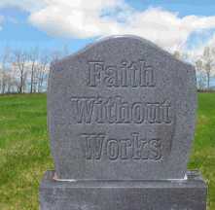
Dead Faith
“What does it profit, my brethren, if someone says he has faith but does not have works” (2:14)
Someone who substitutes words for action
This type of faith is knowledge only

Slide 5
Is knowledge only good enough to save us?
“If a brother or sister is naked and destitute of daily food” (2:15)
How does dead faith respond?
James 2:16
Dead faith only offers words
You cannot fill an empty stomach or warm a cold body with words only

Slide 6
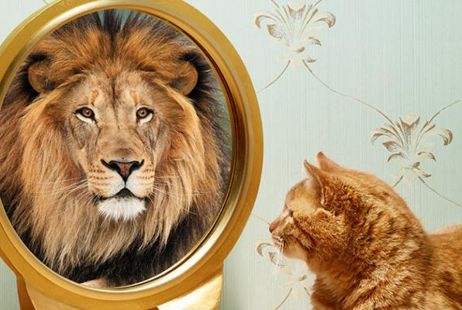
Deceiving Faith
“Someone will say, ‘You have faith and I have works’. Show me your faith without works, and I show you my faith by my works” (2:18)
Are we saved different ways?
Is this the biblical faith we read about?

Slide 7
“You believe that there is one God. You do well” (2:19)
Is it enough to believe there is one God?
“Even the demons believe and tremble” (2:19)
Demons posses this “deceiving faith” (Matthew 8:29)
This was more than the Pharisees
Are demons saved? No
Faith that has no works does not save

Slide 8
Dynamic Faith
Abraham (2:21-24)
He was justified by works when he offered his son Issac (2:21)
Abraham’s Faith was not dead nor deceiving
His “dynamic faith” made him a friend with God (2:23)

Slide 9
Rehab (2:25)
She received the messengers and sen them another way
She housed the enemy of Jericho
She believed in the God of Israel

Slide 10
James showed that obedient faith is the “one faith” that is pleasing to God
Faith without works is dead
What does this say about a member whose faith moves them to no work?
Faith - work = dead and deceiving

Slide 11
WALK BY DYNAMIC FAITH

