Slide 1
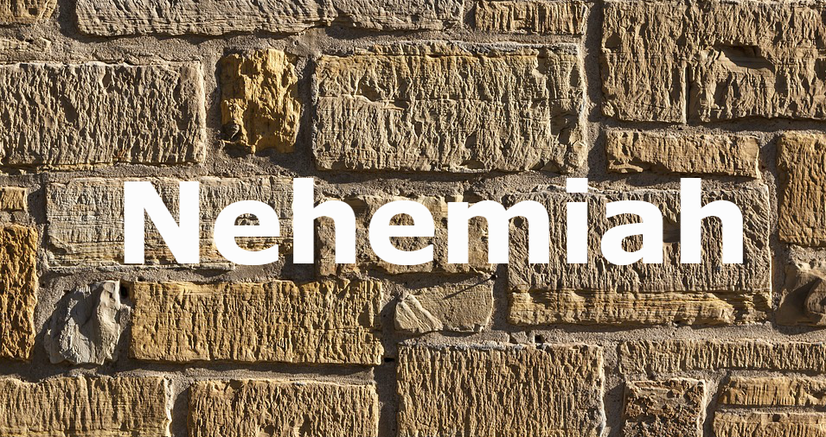
Stone of Examination

Slide 2
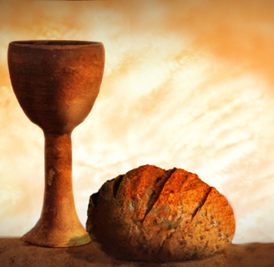
“Examine yourselves”
We are to do this at the Lord’s Supper (I Corinthians 11:28)
We are to do this with the faith (2 Corinthians 13:5)

Slide 3
Examination requires us to look within
Inside the word “examination” is the word “nation”
The Jewish nation had the great task of building the walls of a Jerusalem
They faced opposition from the enemy and fatigued from their own brethren

Slide 4
What about this holy nation (the church)?
I Peter 2:9

Slide 5
The Stone of Examination

Slide 6
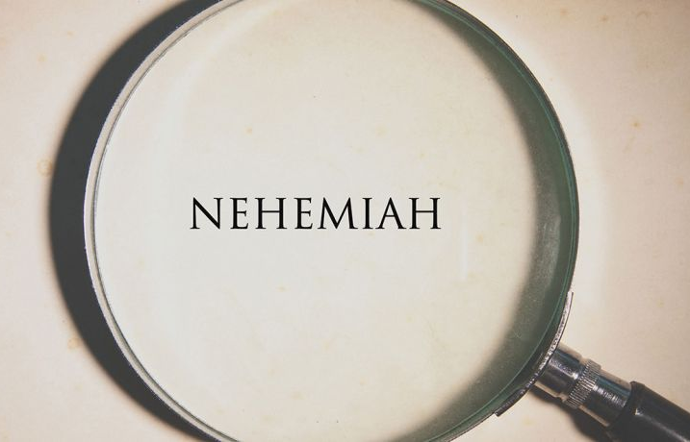
A Great Cry
In the midst of a “great work” (4:29) for a “great God” (1:5), a “great cry” (5:1) was heard among the Jews
This great cry came from within
It was “against their Jewish brethren” (5:1)

Slide 7
The sorrow outside the walls had distressed them (4)
The problems inside the walls had greatly distressed them (5)
What hurts more?

Slide 8
There were families in need of food (5:2)
Jewish families were being neglected of food
Are churches neglected from the spiritual food, the Word?
The landowners had mortgaged their property to buy food because of a famine (5:3)
They were trying to live on more than what they had
Their great debt resulted in their children working for the lender (5:5)

Slide 9
A Great Assembly
Nehemiah became angry (5:6)
Isn’t it frustrating to see God’s people not act right?
Nehemiah opened his mind before his mouth (5:7)
Nehemiah rebuked the nobles and rulers (5:7)
Nehemiah called for a great assembly (5:7)

Slide 10
Nehemiah reminded them of their identity (5:9)
Nehemiah challenged the nobles and rulers to stop charging interest and restore what was charged (5:10-11)
The rulers and nobles agreed to restore what they had taken (5:12)
Nehemiah confirmed this with an oath (5:12)

Slide 11
A Great Example
Nehemiah led by example when it came to helping
He used his position to help and not take from others
Former governors had taken from the people
Nehemiah and his brothers didn’t take from the governor’s provisions (5:14)

Slide 12
Nehemiah led by example in his service
He continued the work on the wall (5:16)
Nehemiah led by example in his giving
At his dinner table, he fed 150 Jews and rulers daily (5:17-18)
Nehemiah shared his money, home, and food for others

Slide 13
Nehemiah asked God to remember him for good
We must do good for God to remember (Galatians 6:10)

