Slide 1
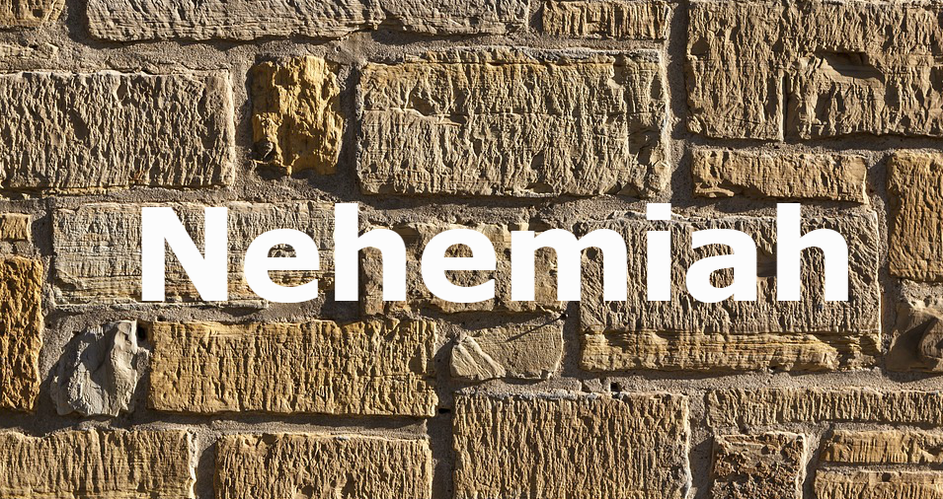
Stone of Conviction

Slide 2
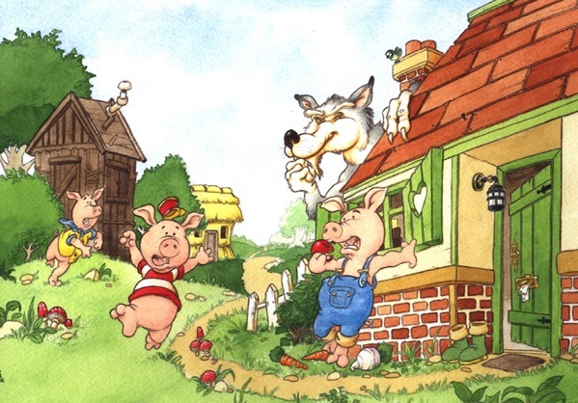
Once upon a time...

Slide 3
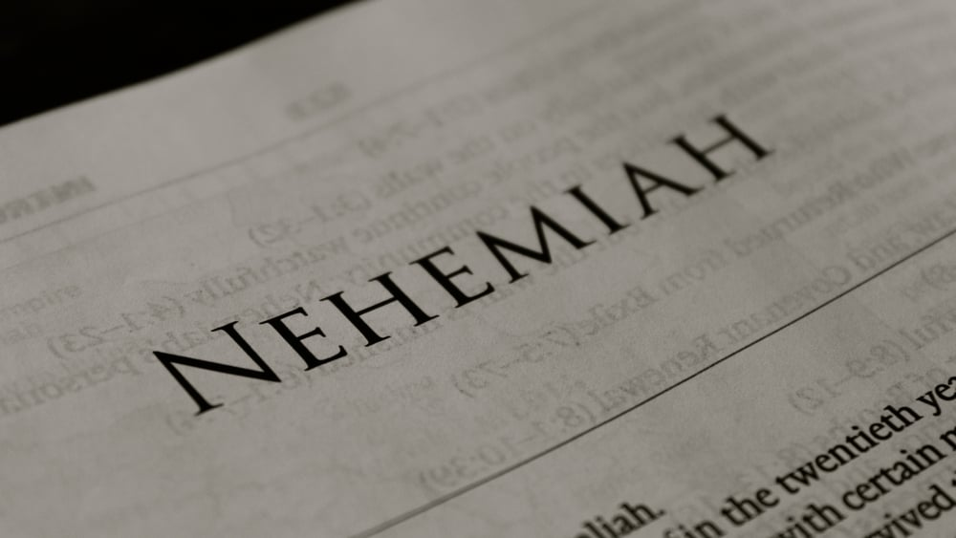
Once upon a time...
Nehemiah organized the building of the wall
The wolves (Sanballat, Tobiah, and Geshem) came in to blow down the walls with their negative words
Nehemiah gathered the builders and reminded them of their conviction
The builders had the conviction to see the work get finished

Slide 4
What about the stones here?
The church is compared to stone not straw or sticks
We are to be stone-like when it comes to our conviction in the Lord and the work
Christianity is a lifelong process!
Some Christians have the conviction of straws and sticks

Slide 5
Paul warned of “savage wolves” (Acts 20:29)
Many have fallen to the winds of liberalism and worldliness
How strong is your conviction?

Slide 6
The Stone of Conviction

Slide 7
They tried Invitation
There is another invitation offered each week
The Lord is not the only one offering an invitation
When the wall had been rebuilt, Nehemiah received an invitation from the enemy
The enemy had tried to stop the work by ridicule, threatening, and attacking the leader
The enemy is persistent

Slide 8
Sanballat and Geshem sent Nehemiah an invitation
Nehemiah saw through their words (6:2)
“I am doing a great work, so that I cannot come down” (6:3)
They didn’t stop after hearing “No” the first time
They tried four times (6:4)
Nehemiah gave them the same answer

Slide 9
Why? He had conviction
What about us?
Those with weak conviction have left the work and tried “unity” meetings
Those wanting unity for the price of truth
Without strong conviction in the truth, we can easily accept the enemies invitation

Slide 10
They tried Intimidation
They sent Nehemiah an open letter of lies (6:5-6)
The letter was open so other eyes could read it and start the rumor mill
If the builders believed the letter, it would create division
Think about the attacks on the church
“I heard that...”
“Did you hear about...”

Slide 11
The only words we are to accept with questioning are the words of God
Everything else should require further review on our part
In the letter, they accused Nehemiah exalting himself as king

Slide 12
Nehemiah denied the report (6:8)
He prayed for strength (6:9)
He went back to work (6:15)
Nehemiah shows us that if we take care of our character, we can trust God to take care of our reputation
When the letter failed, they hired Shemaiah to deceive Nehemiah

Slide 13
We need to have a strong conviction in the truth to endure

Slide 14
They tried Infiltration
The wall was completed in 52 days (6:15)
“In those days the nobles of Judah sent many letters to Tobiah and the letters of Tobiah came to them” (6:17)
The enemy found a weak link among the nobles
Why would the nobles send letters to the enemy?

Slide 15
They believed the letters of Tobiah
We need to learn that we shouldn’t believe everything we read and hear
Their bonds of human connection was stronger than their spiritual affection
Tobiah was kin to some of them (6:18)
The nobles also spoke of the enemy’s good deeds before Nehemiah (6:19)

Slide 16
The last stone needed to complete the wall is the one needed to complete this life-conviction

