Slide 1
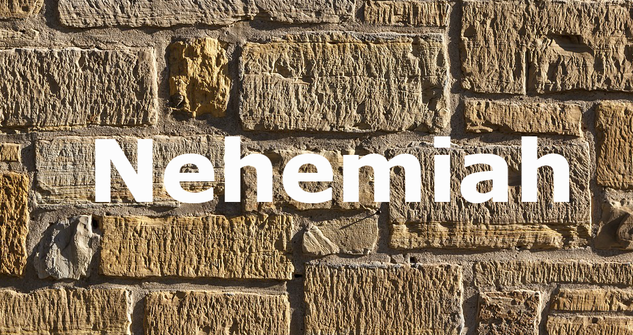
Stone of Dedication

Slide 2
Have you ever noticed how dedicated we are when it comes to starting?

Slide 3
What about the dedication to continue?
Without dedication, businesses fade away
Without dedication, subdivisions deteriorate
Without dedication, marriages end in divorce
Without dedication, resolutions are broken

Slide 4
The challenge of the church is to keep God’s builders dedicated to the work

Slide 5
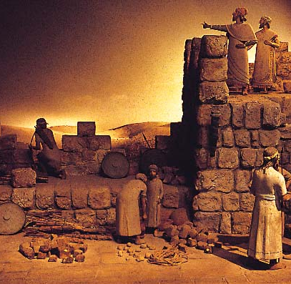
Nehemiah faced the same challenge with the building of the wall
He faced the challenges of destruction and discouragement
He had to keep the workers involved for 52 days (6:15)
Whether 52 days or 52 years, Christ is looking for dedicated workers

Slide 6
The Stone of Dedication

Slide 7
They dedicated their hearts to the work (4:1-8)
“When things are going well, get ready for trouble”
Chapter 4 begins with the enemy
Sanballat mocked the workers by questioning:
Their strength (4:2) “What are these feeble Jews”
Their security (4:2) “Will they fortify themselves”
Their spirituality (4:2) “Will they offer sacrifices”

Slide 8
Their speed (4:2) “Will they complete it in a day”
Their supplies (4:2) “Will they revive the stones from the heaps of rubbish”
How were the people able to work in the environment?
They dedicated their heart (mind) to work (4:6)

Slide 9
How did Nehemiah handle criticism?
He prayed (4:5)
He kept working (4:6)
The enemy will do anything to stop us from working
We need to be dedicated enough to keep on working

Slide 10
They dedicated their hands to the work
It was a trying time for Nehemiah and the builders
The newness of rebuilding had worn out
They were in the rebuilding project trying to continue
Nehemiah 4:10

Slide 11
Can you imagine the blisters, bruises, and sore muscles?
The wall was rising but still more dirt and rubbish
The same problem can plague the church
New ideas and people only go so far
It comes a time to dig in and keep on working

Slide 12
The workers had been threatened by the enemy (4:11)
Fear was spreading through the camp
Nehemiah addressed the threat by establishing a physical protection and a spiritual protection (4:13-14)
They dedicated their hands to the work
With one hand, they were building
With the other hand, they were ready for battle

Slide 13
The builders were spread out enough to rally together at the sound of a trumpet
I Thessalonians 4:16-17
What will you be doing at the sound of the trumpet?

Slide 14
They dedicated their hours to the work
A person’s dedication is determined by the amount of time he/she puts in it
A good parent by the time spent in parenting
A good employee by the time spent on the job
A good builder by the time spent working

Slide 15
“So we carried on the work with half of them holding spears from dawn until the stars appeared” (4:21)
Nehemiah realized every minute, hour, and day was needed
We must be willing to dedicate time in our days to the Lord

Slide 16
The Lord’s work cannot be built by idle hands
Can the Lord count on you?

