Slide 1
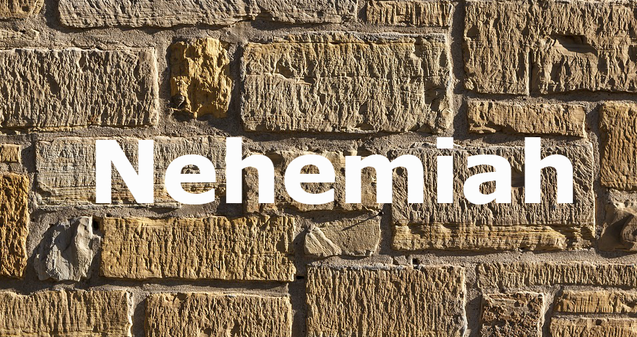
Build Up

Slide 2
The book of Nehemiah opens much like the daily news
The walls of Jerusalem were broken down and the gates burned
Can you remember “when” and “where” you received bad news?

Slide 3
Nehemiah was a person who cared enough to do something about a bad situation
He cared about the hopes of his people’s future
He cared about his heritage and the glory of God
He cared enough to leave the comfort of the palace to rebuild the walls

Slide 4
Do we really care?

Slide 5
“You also, as living stones, are being built up as a spiritual house” (I Peter 2:5)

Slide 6
The stone of care

Slide 7
Nehemiah cared enough to ask
“I asked them...” (1:2)
Nehemiah was aware of the destruction of Jerusalem, 70 years of captivity, and a return of a remnant
He was not aware of the news that came to him
News of a city in ruins and broken down walls
Do we care enough to ask about the Lord’s church?

Slide 8
Nehemiah cared enough to weep
When I heard these words, I sat down and wept and mourned for days” (1:4)
Nehemiah carried his emotions to God
He wept and mourned for days
He wept “flood of tears or loud weeping”
Job’s three friends wept over Job’s loss

Slide 9
Jeremiah described his sorrow over God’s people as his eyes a fountain of tears (9:1)
When a burden is placed on your heart, don’t escape it, for if you do, you might miss the blessing?
Do we care enough to help the load of others?
Nehemiah did!

Slide 10
Nehemiah cared enough to pray
The book of Nehemiah opens and closes with a prayer
He prayed reverently (1:5)
He prayed humbly (1:6)
He prayed continuously (1:6)
He prayed repentantly (1:6)

Slide 11
Do we care enough to talk to God first?
Nehemiah prayed before leaving for Jerusalem
We can easily do something first and then ask God’s blessing after

Slide 12
Nehemiah cared enough to help
“O Lord, I pray, please let your ear be attentive to the prayer of your servant” (1:11)
Can one be a servant and not serve?
Jesus cared enough about situation that He came and died for us
Nehemiah didn’t wait for someone else to do what he could do

Slide 13
God is still looking for people who care enough to ask, weep, pray,, and help

