Slide 1
Charlotte Heights Church of Christ
July 9, 2017
“Could you not watch one hour?”
Mark 14:32-37

Slide 2
Every First Day of the Week – We assemble:
Acts 2:42
“And they continued steadfast in the apostles doctrine and fellowship, in the breaking of bread and in prayers”
Acts 20:7
“Now on the first day of the week, when the disciples came together to break bread, Paul, ready to depart the next day, spoke to them and continued his message until midnight”

Slide 3
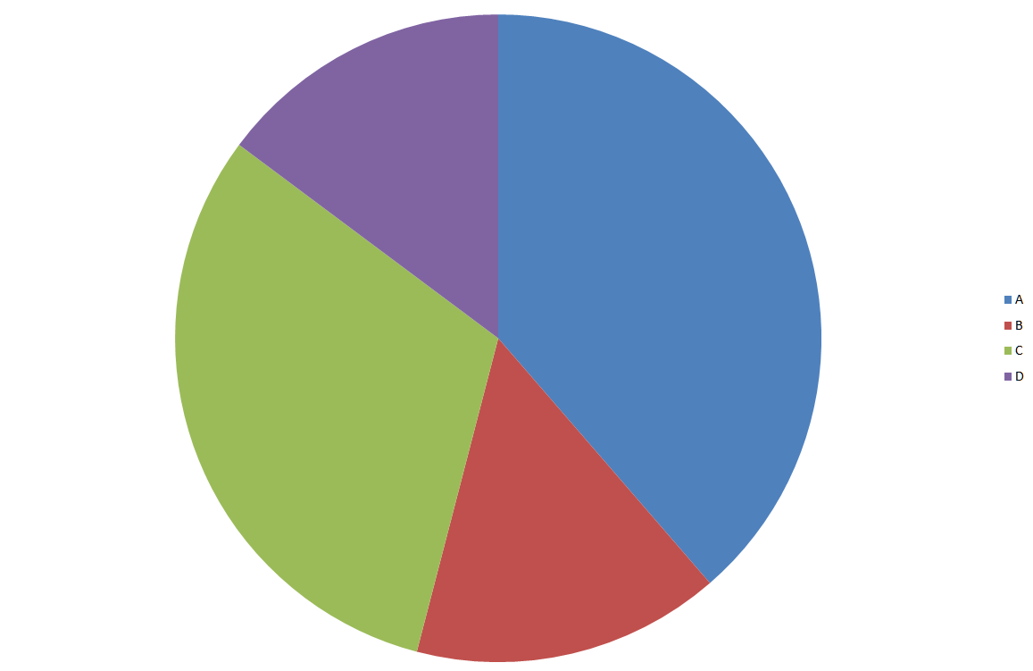
The “Average” Church Service – 1 Hour:
Lord’s Supper – 7 Mins.
Preaching – 25 Mins.
Singing – 20 Mins.
Prayers/Misc. – 8 mins.

Slide 4

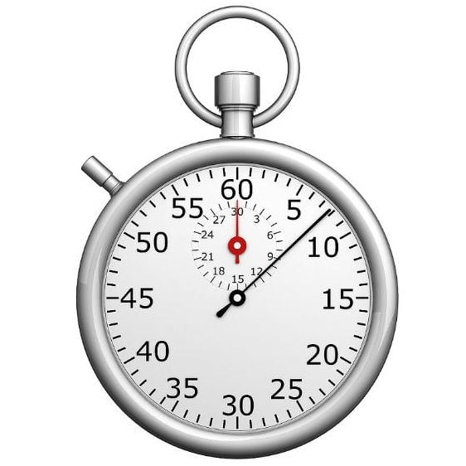
According to a study by Microsoft in May 2015…
The Average attention span of an individual is 8 Seconds!
The average attention span of a goldfish is 9 seconds!

Slide 5
Today’s Worship Service:
“Don’t Lose Focus of the Primary Reason”
²³ For I received from the Lord that which I also delivered to you: that the Lord Jesus on the same night in which He was betrayed took bread; ²⁴ and when He had given thanks, He broke it and said, “Take, eat; this is My body which is broken for you; do this in remembrance of Me.” ²⁵ In the same manner He also took the cup after supper, saying, “This cup is the new covenant in My blood. This do, as often as you drink it, in remembrance of Me.” (I Cor. 11:23-25)

Slide 6
#511
Oft We Come Together

Slide 7
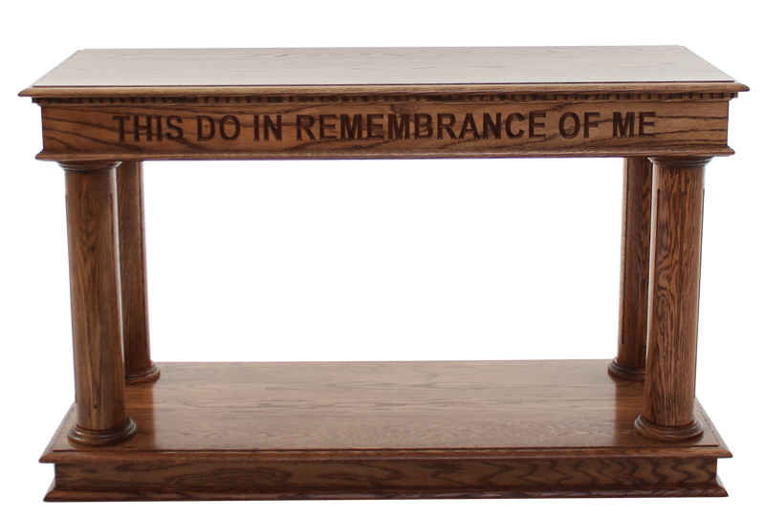
¹⁹And He took bread, gave thanks and broke it, and gave it to them, saying, “This is My body which is given for you; do this in remembrance of Me.” ²⁰ Likewise He also took the cup after supper, saying, “This cup is the new covenant in My blood, which is shed for you.” (Luke 22:19-20)

Slide 8
I. We observe the Lord’s Supper as a Memorial!
“Men build monuments of marble and granite, he seeks the imperishable; but despite all his precautions they molder and crumble. God, through Jesus, selected the perishable bread and volatile fruit of the vine as the materials out of which he would build a monument that would endure with perennial freshness through all time.” (David Lipscomb – Commentary on I Cor. 11)
In the Supper we remember the self-denying spirit and heroic deeds of Jesus Christ for the good of man.

Slide 9
#742
When I Survey the Wondrous Cross

Slide 10
II. In the Supper, we anticipate!
“ For as often as you eat this bread and drink this cup, you proclaim the Lord’s death till He comes.”
(I Cor. 11:26)
When I survey the wondrous cross, on which the Prince of glory died.. What do I See?
The cross was not the end, only the beginning!
(John 14:1-4)

Slide 11
How Deep the Father’s Love

Slide 12
In the Supper, we reflect!
¹⁹And He took bread, gave thanks and broke it, and gave it to them, saying, “This is My body which is given for you; do this in remembrance of Me.” ²⁰ Likewise He also took the cup after supper, saying, “This cup is the new covenant in My blood, which is shed for you.” (Luke 22:19-20)
It was my sin that placed Him there! (Romans 5:7-8)
It was His love for me that held Him there! (John 3:16)

Slide 13
So as we participate in the Supper, may we each find ourselves at the Cross:
Remembering, Anticipating and Reflecting
Song: “They Watched Him There”
The last Verse:
His grace I cannot fathom, yet I hold fast His love.
Though I am not deserving of mercy from above.
I cry for pain He suffered; His grief I cannot bear.
I weep in prayerful silence. I bow and watch Him there.

Slide 14
They Watched Him There

